Slide 1
Intro duction to SQL
SQL Bootcamp

Slide 2
SQL Bootcamp Agenda
01
Intro
Basic SQL Syntax & Queries
Joins & Relationships
Grouping and Aggregating Data
05
Hand On Practice
06
Subqueries & Derived Tables
07
Data Manipulation
08
Best Practices & Performance Tuning
09
Database, Data Warehouse, Data Marts
10
Hands On Practice

Slide 3

Who am I
In 10 years of working, I have held roles as a;
Reporting Analyst
Data Analyst
Data Scientist
Business Intelligence Analyst
The single most useful tool I have used throughout my career is SQL
Grant McKinnon
Senior Manger Data & AI

Slide 4
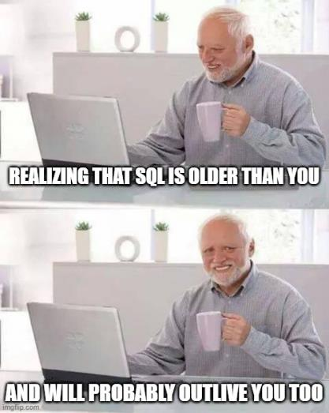
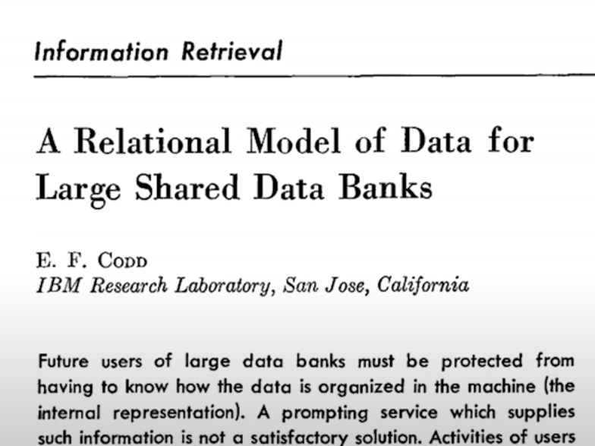

What is SQL?
SQL stands for Structured Query Language (often pronounced sequel)
It was first developed by IBM in the 1970s and has since become an industry standard for database management.
Ted Codd – Father of Databases
Notes:
SQL stands for Structured Query Language and is often pronounced as sequel, though also referred as S-Q-L
Its been around for a long time and the first paper discussing them was published in 1970 by Ted Codd and the database concept has not significantly changed that much over the years and while there are different flavours or syntax’s across different platforms, and is quite consistent in its principals and is the industry standard for accessing data within a database.

Slide 5
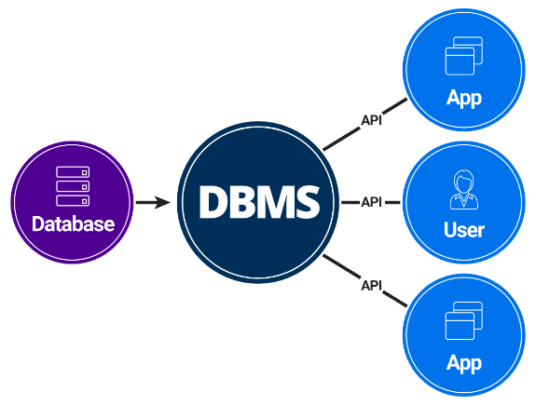
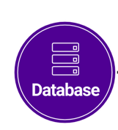
What does SQL do?
SQL is used to:
Query (question or retrieve) information stored in a database.
Insert, Update and Delete records (information) in a database.
Backup Data or export it for use in other tools such as Excel.
SQL
SQL
SQL
Notes:
SQL is used to Query which you could think of a query as a question or to retrieve data or information within a database
We can Insert Data into a database, Update data that is already stored in the database and Delete records in a database
Databases can also be backed-up and datasets exported for use in other tools such as Excel.
I have used other technologies such as Python and R, Power BI and Tableau and others at different organisations but SQL has been the one tool that has been consistent everywhere I’ve been.
Anytime you have Data being stored somewhere, it will be stored in a database (and hopefully not an Excel file)
There are many use cases for SQL from web apps storing and retrieving data via SQL via API’s, which essentially are just wrapping up SQL queries, BI dashboards loading data to visualise, machine Learning models querying data etc.

Slide 6
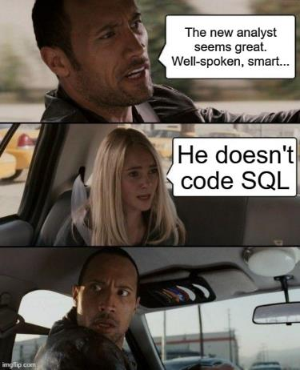
Why should you learn SQL?
It's easy to learn.
It's very standardised.
It's useful in many Data and IT Roles
Companies are dealing with larger and larger volumes of data and in many cases, it can’t be held on a local machine
Notes:
SQL is easy to learn. The language itself is very easy to read and understand once you know the basics and you will be well on the way after these sessions today and tomorrow.
Its standardised and what I mean is, as it has not changed significantly from the 70’s, and for good reasons. Many technologies change over the years but SQL has remained consistent over that time and will for the foreseeable future.
As I said at the start, I’ve been using SQL throughout my career and various roles and it’s the first language I tell anyone looking to work in Data to pick up.
Data is getting bigger and more devices are spitting out data constantly as IoT devices and sensors are becoming more prevalent. This data typically can’t be stored on your local PC nor could you open it in excel Imagine Having terabytes of data you want to analyse. It's not going to fit onto a CSV or Excel file which has a limit of 1 Million rows. You need somewhere you can query and manipulate the data in order to use it.

Slide 7
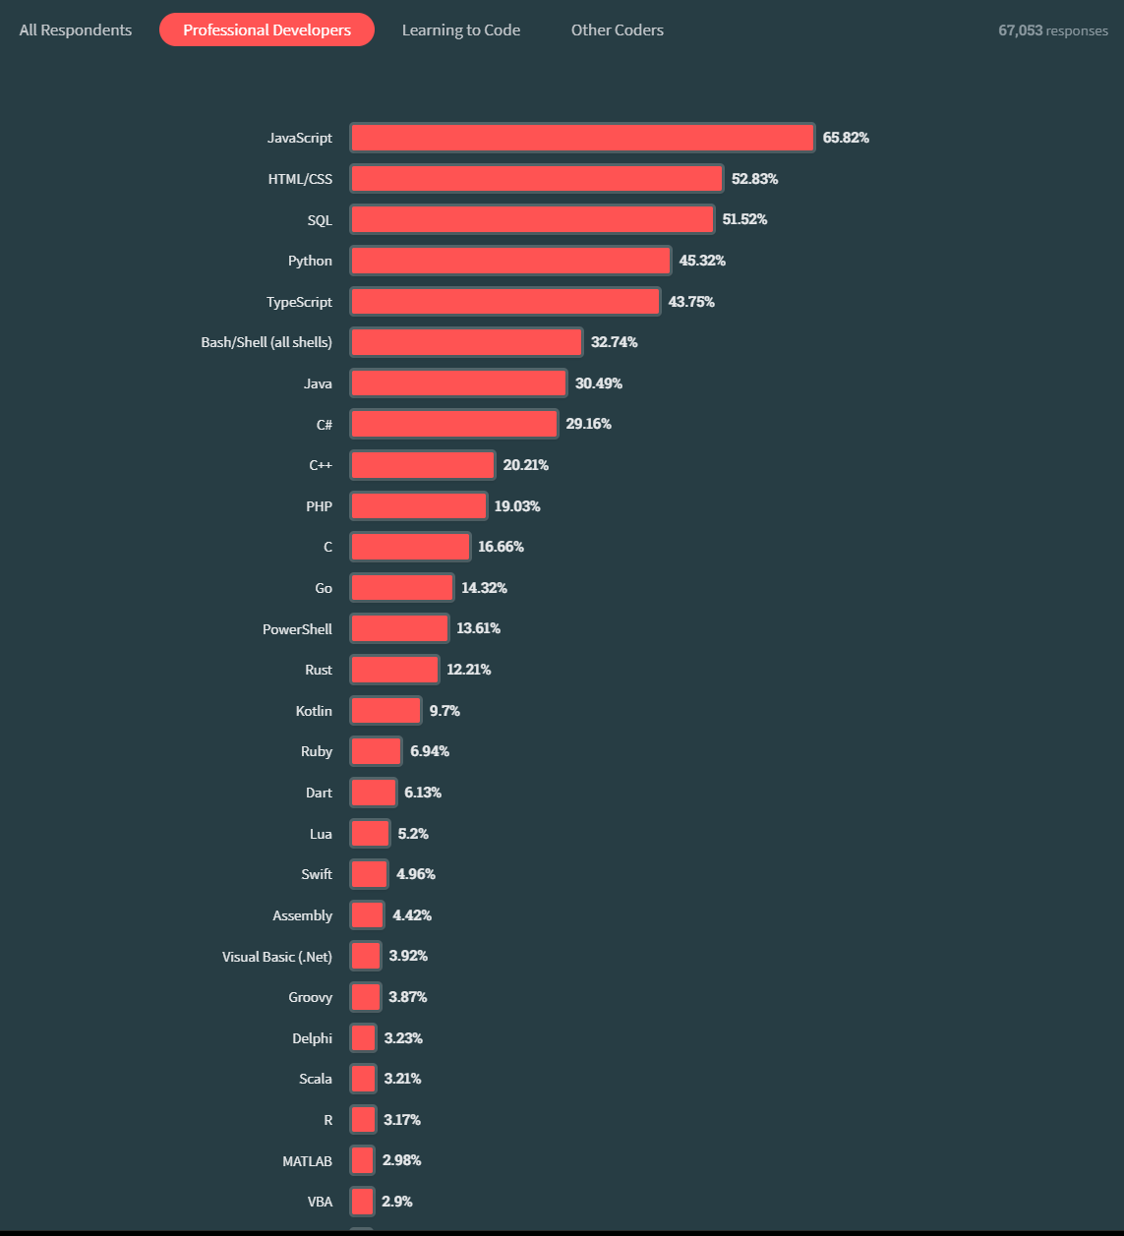

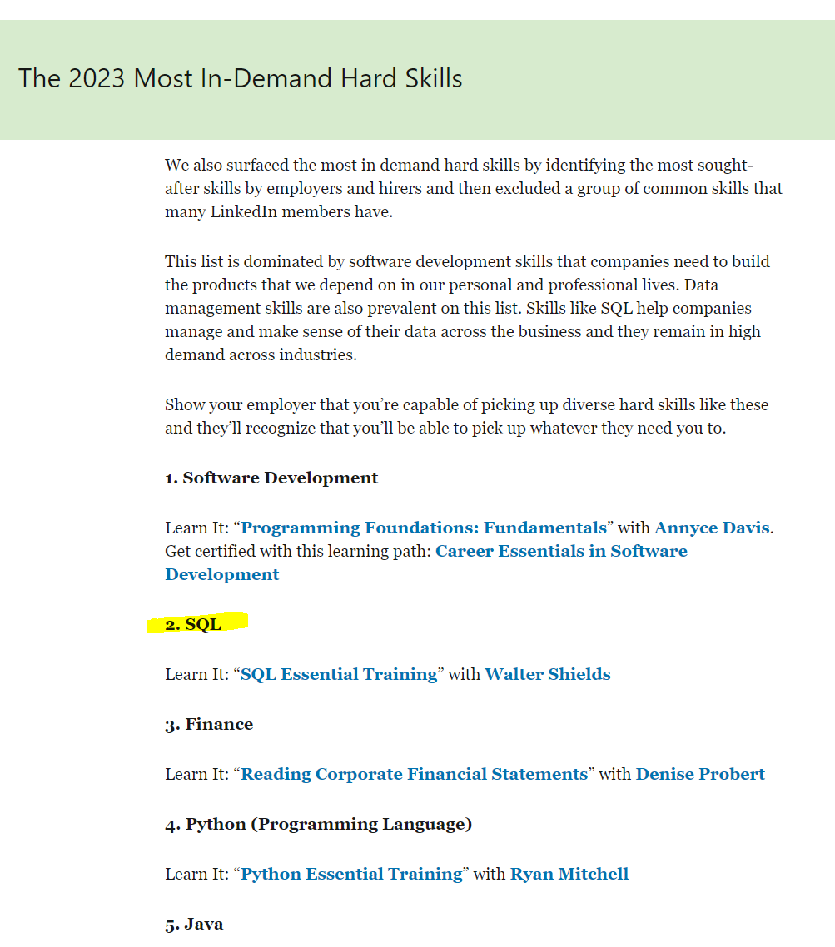

Top Skills for Data Analysts
https://survey.stackoverflow.co/2023/#most-popular-technologies-language-prof
https://www.linkedin.com/business/learning/blog/top-skills-and-courses/most-in-demand-skills
Notes:
Here is Stack Overflows 2023 developer survey which shows the most in-use languages for professional developers. This top of the list has not changed for 11 years with JavaScript being the most popular used language followed by HTML/CSS. SQL is number 3 with Python closely following which has been rising up the list over the last few years,
LinkedIn also published the 2023 most in demand skills where SQL has come out at number 2 in front of popular languages such as Python and Java.

Slide 8
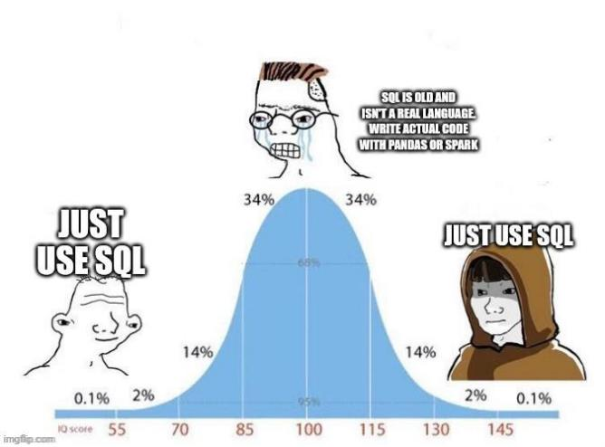
SQL's Role in Data Analysis (and Business Inteliegence)
SQL plays a crucial role in data analysis by enabling users to interact with and analyse large datasets.
Data analysts use SQL to write queries that extract, filter, and aggregate data, allowing them to answer critical business questions.
SQL can be used to transform data before loading into BI tools such Power BI or Tableau
Notes:
1. As a data analyst, their job is not only to analyse the data that is already available but also to be able to retrieve, modify and access the data from the data source, usually a database. The data analyst will use SQL to do query the data and gain insights from it.

Slide 9
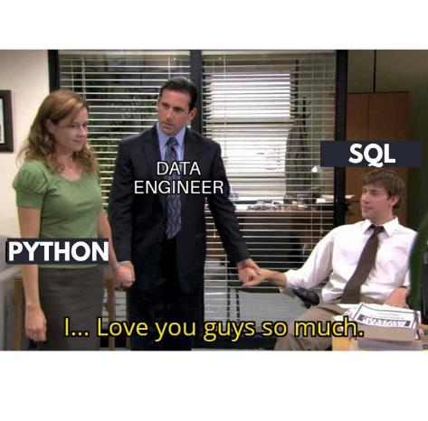
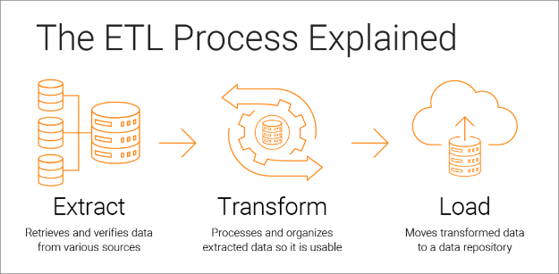
SQL's Role in Data Engineering
Data engineers utilise SQL to define the structure of databases, including tables, columns, and data types.
SQL is essential for ETL (Extract, Transform, Load) processes, where data is extracted from various sources, transformed into a consistent format, and loaded into a database for analysis.
Performance optimisation and indexing are key aspects of data engineering where SQL expertise is required.

Slide 10
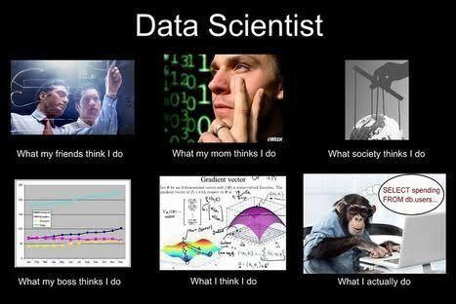
SQL's Role in Data Science
Data Scientists, like Data Analysts need data which in many cases will be stored in a database.
Machine Learning Models can source data from a database for training and outputs can be stored in back a database to be used in Web Apps, Dashboards etc.
Tip: Avoid loading large datasets into ‘in memory’ tools to do aggregations and joins – Do this in the Database

Slide 11

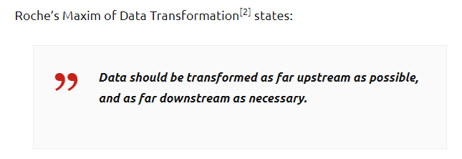
Roche’s Maxim
Notes:
Matthew Roche is a Long time Microsoft Employee, now Program manager for the Power BI team but he has become somewhat famous for his Principal or (maxim) that data should be transformed as far upstream as possible, and as far downstream as necessary.
In the context of extracting data for use in analysis or creating a dashboard etc, “upstream” means closer to where the data is originally produced, and “downstream” means closer to where the data is consumed.
By transforming data closer to its ultimate source costs can be reduced, and the value added through data transformation can be applied to a greater range of uses.

Slide 12








What does it mean?
New Data
Raw Data
Data stored in a Database
Power BI Model
Dashboard
Transformations/
Aggregations/
Value Add
Wastes Compute Resources
Time Consuming
Logic Locked in Power BI
Large Data Volumes Cost to Transport

Slide 13


A Better Approach
New Data
More Efficient in Database
Data stored in a Database
Power BI Model
Dashboard
Transformations/
Aggregations/
Value Add
Other Use Cases

Slide 14
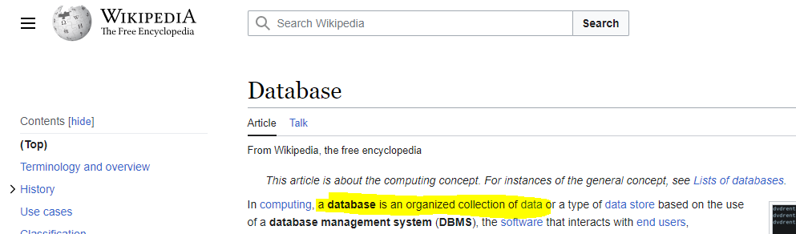
What is a Database
SQL is used to:
Query (question or retrieve) information stored in a database.
Insert, Update and Delete records (information) in a database.
Notes:
What is a Database.
You will recall in a previous slide that SQL Is used to Query, Insert, Update and Delete Data from a Database. But what is a Database.
Wikipedia’s definition is that a database outside the context of computing, is a collection of related Data. This could be a paper record kept by a Hospital, a Phone book (Do they still have those?) but if you don’t know it is a big book of people's names and phone numbers printed alphabetically. By this definition these can all be considered Databases.
Within the context of Computing, we would typically consider a Database as a collection of Data stored and accessed electronically. We use whats known as a database management system or DBMS which acts as the interface between us and the database.

Slide 15

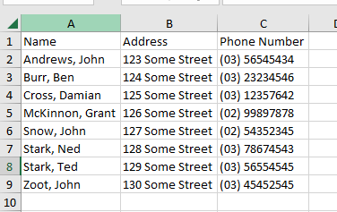
A Database is like an Excel Spreadsheet
Columns (or Fields)
Rows (or Records)
Notes:
A database, like Excel, organises data in structured tables and allows for efficient data retrieval and organisation. However, databases are designed to handle larger datasets, enforce data integrity, and support more complex data analysis, making them suitable for a wide range of applications.
Some companies will use Excel like a Database (looking at you Accounting Teams) but for majority of companies, web apps, websites they will use Databases to store their data.

Slide 16
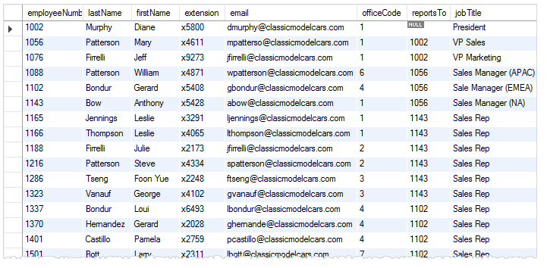
What is a Table
A Table is like a sheet/Tab in an Excel File (each has a unique name)
Columns are equivalent in both
Rows are equivalent in both
Notes:
In a database there are lots of tables. This is an example of a table in a database. This example we can call the Employee table.
You can see it looks like a table in a excel spreadsheet. It has Rows, it has columns, but it is a table in a database.

Slide 17
Database and the Database Management System (DBMS)
If the database represent the data, then then DBMS represents the interface to interact with that data
SQL
SQL
SQL
You can think of these as one product
Notes:
Database management systems (DBMS) are computer programs that allow users to interact with a database. A DBMS allows users to control access to a database, write data, run queries, and perform any other tasks related to database management.
The most well known DBMS’s are SQL Server, MySQL, PostGreSQL, Oracle etc.

Slide 18
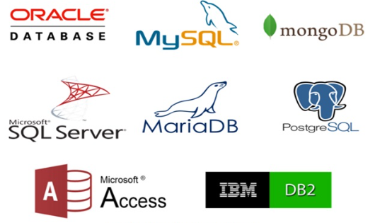
Flavours of DBMS’s
SQL is “mostly” the same everywhere but there are minor differences across Platforms.
Each Database management system (DBMS) has its own slightly different flavour of SQL:
PostgreSQL (often called Postgres for short)
Microsoft SQL Server (usually called SQL Server)
MySQL
Oracle
Microsoft Access
And many others..
All of these could be;
Hosted on-premise (in a physical server) OR
Hosted on the Cloud
Notes:
For the most part the SQL language is the same everywhere but there can be some minor differences across different database management system.

Slide 19




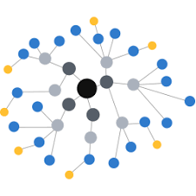
Relational and Non-Relational Databases
Relational Databases
Non-Relational Databases
SQL Databases
NoSQL (Not only SQL) database
Documents (JSON)
Key-Value Pairs
Table Based
Column Stored
Graphs
SQL
SQL
UnQL (Unstructured Query Language)
Notes:
Now, I just want to briefly touch on the main 2 types of databases. The focus on this bootcamp is on Relational Databases but you may come across Non-relattional databases so its good to know they key differences and use cases.
Relational databases are used to store data in a structured table-based manner. All the data remains easily accessible, linked and related to support relations. The main characteristic of a relational database is that it always stores data in tables using rows and columns. Most relational databases use Structured Query Language; so they are often called SQL databases and use SQL for querying and modifying data.
Non-relational databases work in a completely different way to store semi-structured data. They don’t apply a rigid structure, thus introducing more dynamic schemas for unstructured data processing.
This type embraces all the database types that can’t follow the relational structure and traditional SQL syntax.
If SQL databases fall under the table-based category, NoSQL databases can be divided into several categories. The most common types of Non-relational databases include:
Document databases collect, process and retrieve data as JSON-like documents.
Key-value stores arrange data in a key-value format where keys serve as unique identifiers.
Wide-column stores organize data into flexible columns to be spread across database nodes and multiple servers. It supports varying the column format regardless of the row in the same table.
Graph databases are single-purpose platforms to create and manipulate graphs where data is presented in the form of nodes, edges and properties.
It doesn’t mean they don’t apply SQL language. Most of them use both SQL and UnQL (Unstructured Query Language).
Therefore this type can also be referred to as NoSQL (not only SQL) databases.

Slide 20

Types of Data
Notes:
Now, I do also want to briefly touch on the 2 main categories of data, structured and un-strucuturted.
Structured data is our data that is in the form of columns and rows, so tables.
Unstructured data is everything else so things like the JSON documents we discussed on the previous slide but it also includes images, videos, sound, word documents etc.
These can not be stored as is in a database like a table can.
So how is unstructured data handled in a modern data platform?

Slide 21
Why do we need a Database
Name | Phone Number
Andrews, John | (03) 56545434
Burr, Ben | (03) 23234546
Cross, Damian | (03) 12357642
McKinnon, Grant | (02) 99897878
Snow, John | (02) 54352345
Stark, Ned | (03) 78674543
Stark, Ted | (03) 56554545
Zoot, John | (03) 45452545
What is Ted Stark’s Phone Number?
Find all the People with first name John
Find all the people who have (02) as the Area Code
Find all the people with 3 letter names
Notes:
Taking a step back, Why do we need a database, it won’t come as any surprise that storing data digital is much more efficient than on paper. Using the Phone book example imagine we have a book with 10,000 names and phone numbers in it.
You might need to find Ned Stark’s forgotten brother Ted’s phone number. Knowing that the surnames are sorted alphabetically you can easily find Stark and then Ted.
Now, maybe you need to find all the people with first Name John. This would have you going through page by page finding all the records with John as the first name. Pretty time consuming.
Another example that is impractical to do manually, is finding all the people who have area codes of 02.
Or finding all the people who have 3 letter first names.
This is where a database and SQL comes in and you will see in the next session that we can answers these types of questions very easily with SQL.

Slide 22
What is a Table
A Table is like a sheet/Tab in an Excel File (each has a unique name)
Columns are equivalent in both
Rows are equivalent in both
Notes:
Looking back at our table example, typically this is how a table will look in the database but we will normally have many more tables in the database that we will need to use SQL to join together to get the output we need.

Slide 23

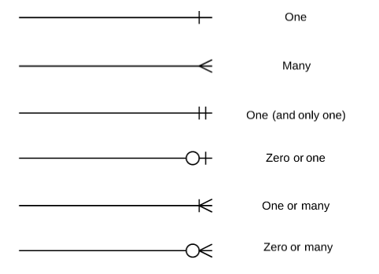
How do we ‘relate’ tables
Tables join to other tables via relationships
crow's foot notation
Notes:
As previously mentioned, A Database is a collection of tables. Tables contain information.
Here’s an example Relational diagram showing you several tables in a sample database and how they relate to each other.
Customers: stores customer’s data.
Products: stores a list of product data
ProductLines: stores a list of product line categories.
Orders: stores sales orders placed by customers.
OrderDetails: stores sales order line items for each sales order.
Payments: stores payments made by customers based on their accounts.
Employees: stores all employee information as well as the organisation structure such as who reports to who.
Offices: stores office data.
Relationships are used to represent how tables can be joined together. There are different types of notation used, a column one used here is known as Crows Foot notation.
It’s a little tricky at first, but we can look at Employees and Offices. This shows us that 1 and only 1 office can have 0 or many employees and looking the other way, an employee can only belong to 1 and only 1 office.
Another example is One Customer can make many orders, but an order can only belong to 1 customer.
They Key to joining these tables is by using defined Keys.

Slide 24
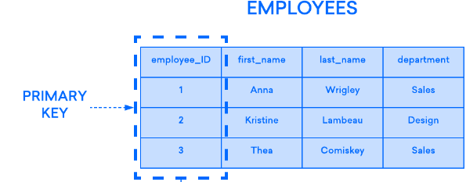
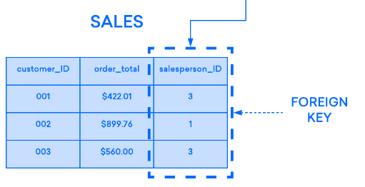
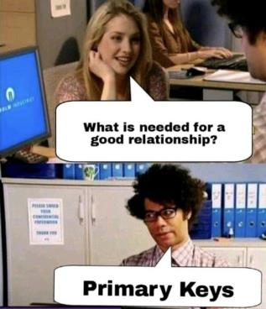
Keys and Relationships
Each Table in a relational database should have a defined Primary Key
The Primary key must be unique
To link a table to another table, it needs to have the primary key of the parent table known as a Foreign key
Notes:
In a relational database each Table should have a Primary key which acts as the unique identifier for that record or row.
Here we see that the Primary Key on the employees table is the foreign key in the sales table, so we can tell which sales person made each Sale.
This avoids duplicate records. For example if we didn’t have a key on the Employees Tables, and we had another Anna Wrigley from Sales, how do we know which one made a Sale?
You might be thinking, why not store all the data into one big table and avoid all the table joins.

Slide 25
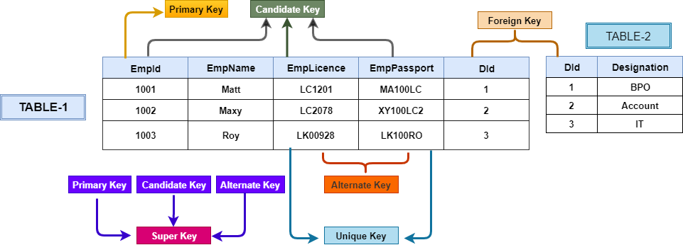
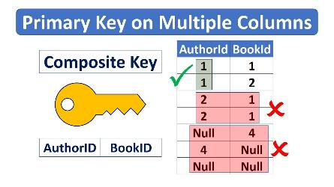
Other types of Keys
Notes:
Primary Key is a column or set of columns that uniquely identify each record in a table and can't have duplicate or null values. Each table can have only one primary key.
Candidate Key is an attribute or set of attributes that uniquely identify rows in a table. A table can have multiple candidate keys, but one is chosen as the primary key.
Alternate Key is any key that isn't selected as the primary key when multiple options exist for a primary key.
Super Key is a set of one or more columns that can uniquely identify all the rows in a table, and it includes candidate keys. From the super key, you choose the primary key for a table.
Foreign Key is used to create relationships between tables, with its values matching the primary key in another table. It helps maintain data and referential integrity.
Unique Key is a column or set of columns that ensure each record's uniqueness in a table, allowing one null value, unlike a primary key, which cannot have null values.
Composite Key is a set of multiple attributes that, when considered together, uniquely identify each record in a table, even if the attributes themselves aren't unique individually.

Slide 26
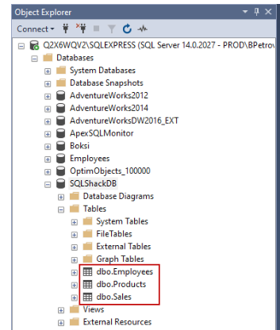
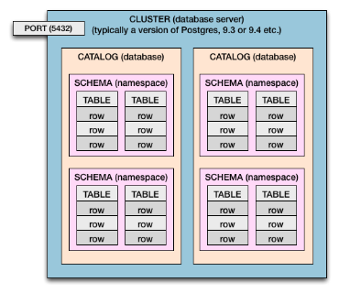
Some key Terms
Cluster (Server)
The physical Cluster (Could be a on-prem sever or a Virtual Machine in the Cloud)
Catalog (Database)
A set of schemas that constitute the description of a database (usually just referred as the “Database”)
Schema
The structure that contains descriptions of objects created by a user (base tables, views, constraints)

Slide 27
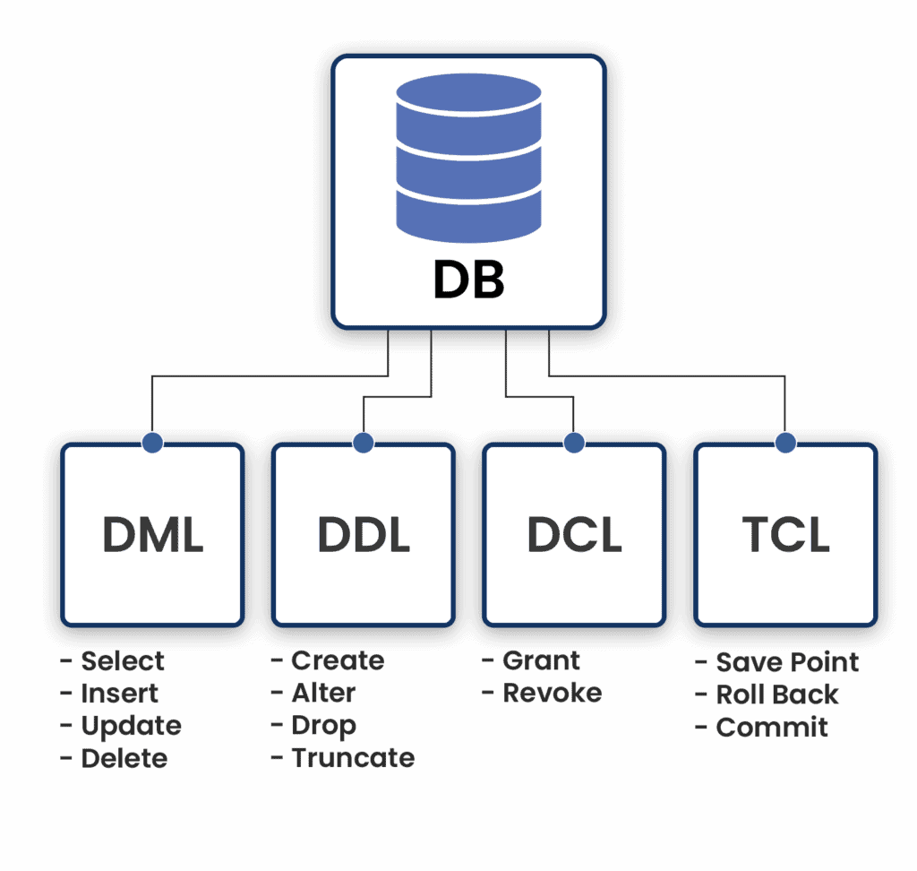
Some key Terms
Data Manipulation Language (DML)
Commands that maintain and query a database SELECT, INSERT, UPDATE, DELETE
Data Definition Language (DDL)
Commands that define a database, including creating, altering, and dropping tables and establishing constraints CREATE, DROP, ALTER, TRUNCATE
Data Control Language (DCL)
Commands that control a database, including administering privileges and committing data GRANT, REVOKE
Transaction Control Language (TCL)
Commands that control a database, including administering privileges and committing data COMMIT, SAVE POINT, ROLL BACK
Notes:
SELECT: It is used to retrieve data from the database.
INSERT: It is used to insert data into a table.
UPDATE: It is used to update existing data within a table.
DELETE: It is used to delete records from a database table.
CREATE: This command is used to create the database or its objects (like table, index, function, views, store procedure, and triggers).
DROP: This command is used to delete objects from the database.
ALTER: This is used to alter the structure of the database.
TRUNCATE: This is used to remove all records from a table, including all spaces allocated for the records are removed.
GRANT: This command gives users access privileges to the database.
REVOKE: This command withdraws the user’s access privileges given by using the GRANT command.
TCL I personally have not used much before,
COMMIT: Commits a Transaction.
SAVEPOINT: Sets a save point within a transaction.
ROLLBACK: Rollbacks a transaction in case of any error occurs.

Slide 28
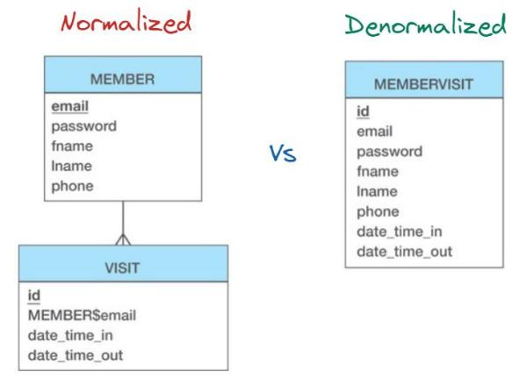
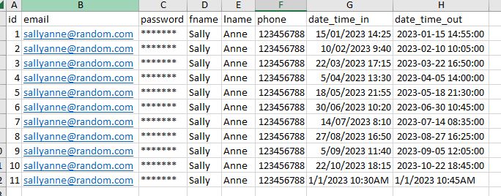
Normalisation and denormalisation
Normalisation = Divide data into more tables
Denormalisation = Combine Data into fewer tables
Denormlaised
Lots of Repeated Values
Notes:
You might be thinking, why couldn’t we just load all the data into 1 big table?
The key is the concept of Normalisation and denormalization.
Normalization is the technique of dividing the data into multiple tables to reduce data redundancy and inconsistency and to achieve data integrity. On the other hand, Denormalization is the technique of combining the data into a single table to make data retrieval faster.
You will see the tables on the right where we have members and visits in 2 tables, this means that each member will only appear once in the Members tables whereas in the denormalised example, every time a member makes a visit, the members details are stored every time. This is duplicate data and and would slow down the insertion and modification of records in this database system.
Normalization is used in an OLTP system, which emphasizes making the insert, delete and update anomalies faster such as a database used to store live sales transations. The other hand, Denormalization is used in an OLAP system, which emphasizes making the search and analysis faster such as in a Data warehouse.
Data integrity is maintained in the normalization process while in denormalization data integrity harder to retain.
Redundant data is eliminated when normalization is performed whereas denormalization increases the redundant data.
Normalization increases the number of tables and joins. In contrast, denormalization reduces the number of tables and joins.
Disk space is wasted in denormalization because the same data is stored in different places. On the contrary, disk space is optimized in a normalized table.

Slide 29
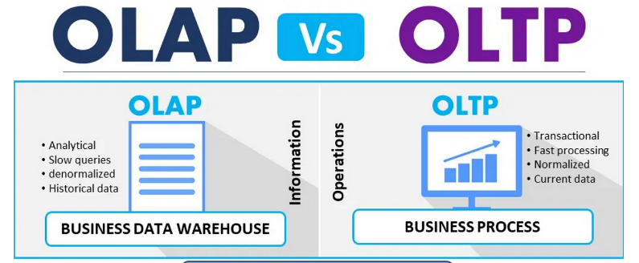
OLTP and OLAP
OLTP = Online Transactional Processing
OLAP = Online Analytical Processing
OLTP = More Normalised
OLAP = More Denormalised
OLTP = Optimised for Fast Inserts to Tables
OLAP = Optimised for Fast Analytical Queries
OLAP can be further split into;
Multidimensional OLAP (MOLAP / OLAP Cube) = data stored in multidimensional arrays that are pre-aggregated into all possible combinations (Sales might be aggregated by product, time, and store location)
Relational OLAP (ROLAP) = stores data in relational database in the form of rows and columns and present the data to end user in multi-dimensional cubes dynamically
Notes:
OLTP, or Online Transactional Processing works with transactional data. It captures and records transactions as individual records in a database. The simplest example where an OLTP system is used is Shopping Transactions. A Shop keeps a record of individual transactions and these records are updated frequently, which is a feature of OLTP systems.
Compared to an OLTP system, an OLAP system runs complex queries on large datasets for business intelligence. The focus in OLAP systems is on fast query performance

Slide 30
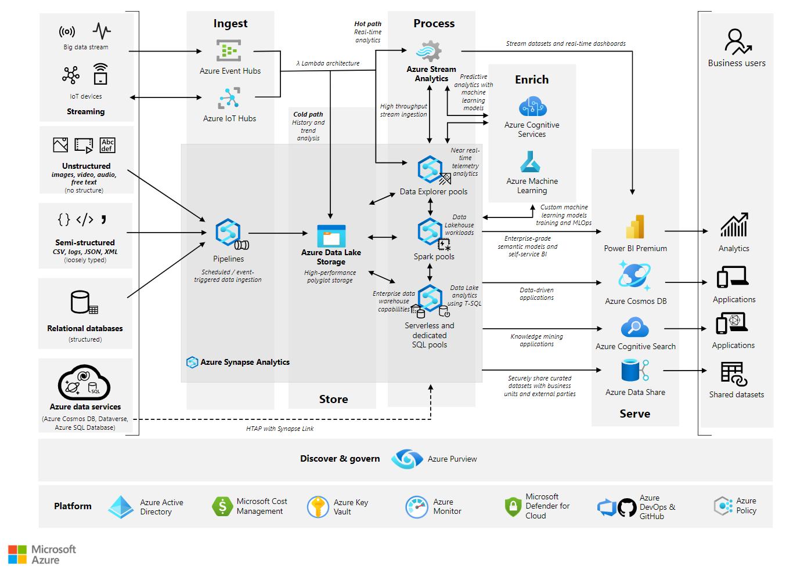
Example of a Modern Data Platform in Azure
SQL Databases can be a source of data for a modern cloud data platform
Data Lakes can store both structured data and unstructured data either batched or from streaming devices
Processing is done on data in the lake to convert it to a useable format, typically Tabular data. This can be done using Python and other languages or SQL in some cases
The processed data can be stored back in the Lake or in another Database such as a Data Warehouse
The Data can then be used in BI tools such as Power BI, Machine Learning or in many ways.
Notes:
Now, I hope this is not too overwhelming but I just want to focus on a few key components as its likely you guys will be exposed to data platforms such as this.
Typically we will ingest all sorts of data into a Data Lake which can bs structured and from an existing relational database or unstructured.
You can think of the Data Lake storage as just a file storage, such as when you store files in your documents on your PC, it’s a very similar concept.
You can then process your data and you might use SQL or other languages depending on the type of data it is.
You can do this processing in real time, or batch it and store the processed data back in the lake, or in another Database such as a Data Warehouse, which will be covered in a later session.
Once you have the data processed into a useable format, it can be sent to the downstream applications such as BI tools, Machine Learning tools, or into Web applications etc.

Slide 31
Summary
Database
A database is an organised electronic repository for efficiently storing and managing data, used for various purposes, including business records and applications. It's managed with database management systems (DBMS).
DBMS
A database management system (DBMS) is software that organises data into various database architectures like relational (RDBMS), document store, key-value store, column-oriented, graph, and more. Common DBMSs include MongoDB, Cassandra, Redis, MySQL, SQL Server, SQLite, Oracle, and many more.
Relational Databases
A relational database is a structured data storage system that uses tables to organise and manage data, enabling efficient storage and retrieval. It is commonly used in applications like business software and e-commerce platforms.
Non-Relational Databases
A non-relational database, also known as a NoSQL (Not Only SQL) database, is a type of database system that doesn't use the traditional tabular, structured approach of relational databases. Instead, it's designed to handle unstructured or semi-structured data and allows for more flexible data modelling.
Primary Keys
In the relational model, a primary key is a unique identifier for a table's data row, commonly consisting of a single attribute like user ID or a combination of attributes like first name, last name, and city. However, the suitability of a primary key can vary between different situations.
Foreign Key
In the relational model, a foreign key links an attribute or attributes from one table to another table's primary key, reducing data duplication and enhancing accuracy. For instance, it can link a street address to a city and country, streamlining data input.
Structured Query Language (SQL)
A database management system (DBMS) is software that organises data into various database architectures like relational (RDBMS), document store, key-value store, column-oriented, graph, and more. Common DBMSs include MongoDB, Cassandra, Redis, MySQL, SQL Server, SQLite, Oracle, and many more.
Normalisation
Normalisation is the technique of dividing the data into multiple tables to reduce data redundancy and inconsistency and to achieve data integrity.
Denormalisation
Denormalisation is the technique of combining the data into a single table to make data retrieval faster.
OLAP
Online Analytical Processing system runs complex queries on large datasets for business intelligence. The focus in OLAP systems is on fast query performance
OLTP
Online Transactional Processing works with transactional data. It captures and records transactions as individual records in a database. The simplest example where an OLTP system is used is Shopping Transactions. A Shop keeps a record of individual transactions and these records are updated frequently, which is a feature of OLTP systems.

Slide 32


Slide 33
BASIC SYNTAX
Agenda & Table of Contents
1
SELECT
2
WHERE
3
ORDER BY
4
QUIZ
Notes:
Tags: agenda, list, numbers

Slide 34

Give me just the data I care about!
text
Select statements are the basis of querying data using SQL
ID | Name | Age | Position | Income
tbs027 | Carmen | 32 | Head Chef | 175,000
tbs028 | Sydney | 26 | Sous Chef | 132,000
tbs002 | Richie | 45 | Manager | 160,000
tbs015 | Ebraheim | 47 | Line Cook | 90,000
tbs006 | Tina | 51 | Line Cook | 90,000
tbs021 | Marcus | 35 | Pastry Chef | 94,000
How would I answer questions like:
Retrieve all details of our employees that earn above 100,000? What is the average age of employees?
Name the oldest line cook?
Notes:
Tags: text, list, principles

Slide 35
Retrieve details of employees that earn above 100,000?
text
Select statements are the basis of querying data using SQL
ID | Name | Age | Position | Income
tbs027 | Carmen | 32 | Head Chef | 175,000
tbs028 | Sydney | 26 | Sous Chef | 132,000
tbs002 | Richie | 45 | Manager | 160,000
tbs015 | Ebraheim | 47 | Line Cook | 90,000
tbs006 | Tina | 51 | Line Cook | 90,000
tbs021 | Marcus | 35 | Pastry Chef | 94,000
SELECT * FROM theBearTable WHERE Income > 100000;
Will return all columns for the first 3 highlighted rows
Notes:
Tags: text, list, principles

Slide 36
What is the average age of our employees?
text
Select statements are the basis of querying data using SQL
ID | Name | Age | Position | Income
tbs027 | Carmen | 32 | Head Chef | 175,000
tbs028 | Sydney | 26 | Sous Chef | 132,000
tbs002 | Richie | 45 | Manager | 160,000
tbs015 | Ebraheim | 47 | Line Cook | 90,000
tbs006 | Tina | 51 | Line Cook | 90,000
tbs021 | Marcus | 35 | Pastry Chef | 94,000
SELECT AVG(age) AS average_age FROM theBearTable;
Will return a single column and row called ‘average_age’ and the value 39.33
Notes:
Tags: text, list, principles

Slide 37
Name the oldest line cook?
text
Select statements are the basis of querying data using SQL
ID | Name | Age | Position | Income
tbs027 | Carmen | 32 | Head Chef | 175,000
tbs028 | Sydney | 26 | Sous Chef | 132,000
tbs002 | Richie | 45 | Manager | 160,000
tbs015 | Ebraheim | 47 | Line Cook | 90,000
tbs006 | Tina | 51 | Line Cook | 90,000
tbs021 | Marcus | 35 | Pastry Chef | 94,000
SELECT name AS oldest_LC FROM theBearTable WHERE Position = ‘Line Cook’ ORDER BY age DESC LIMIT 1;
Will return a single column and row with column name ‘oldest_LC’ and a single value ’Tina’
Notes:
Tags: text, list, principles

Slide 38
…Everything starts with a select
text
Subheader
select
column
from
table
clause
select
*
from
table1
where
id = ‘tbs027’;
select
*
from
table1
where
income > 100,000;
select
id
from
employees
where
id = ‘tbs027’ and income > 100,000;
select
id, name
from
Table2;
✓ also valid. I like to limit the amount of data we operate on where possible
Notes:
Tags: text, list, principles

Slide 39
There are many ways to be choosy in SQL with a ‘where’ clause
text
Subheader
where employee = ‘john’
where name in (‘James’, ‘Laura’, ‘Alex’) and age in (24, 25, 28)
where current is false -> or even ‘where current’ (shorthand)
where name like ’%John%’
where (name = ‘xyz’ and age > 25)
where (name = ‘xyz’ or age > 25)
where len(name) = 4
where income is not null
…and many more! Ask chatGPT Do some research for your particular use case!
Notes:
Tags: text, list, principles

Slide 40
ORDER BY and LIMIT
text
Subheader
ORDER BY
Allows us order by ascending or descending values – can be used for dates or amounts
Need to specify the column we are ordering by
Specify if we are ordering by ascending or descending (defaults to ASC if not specified)
E.g. SELECT name, age FROM employees ORDER BY age DESC
E.g. SELECT name, position FROM employees ORDER BY Income ASC
E.g. SELECT name, date_of_birth FROM employees ORDER BY date_of_birth
LIMIT
Super simple – allows us to limit the number of results returned, e.g. 1, 5, 1000
E.g. SELECT name, age FROM employees ORDER BY age DESC LIMIT 1;
-> Will return the oldest employee.
Ask chatGPT Do some research for your particular use case!
Notes:
Tags: text, list, principles

Slide 41
…Order of operations matters
text
Subheader
column/transformed column
AS
SELECT
New name(s)…
FROM
table
WHERE
conditions…
ORDER BY
column
ASC/DESC
LIMIT
1;
Notes:
Tags: text, list, principles

Slide 42
Time to check we’re all still awake…
text
Subheader
Example Syntax
Select name, age from employees where (id in (’tbs002’, ‘tbs007’, ‘tbs0028’) and position = ‘line chef’);
Select feature_name as name = ‘xyz’ from Table1 where id is not null;
Select name, age from employees order by age ASC limit 1;
Practice Questions
Worked Example: Find the shortest 3 tracks composed by either Caetano Veloso or Gilberto Gil which are under 10 million Bytes
Name the oldest Sales Support Agent
Select the 5 shortest tracks by AC/DC
Find the Name and Composer of tracks above 10 million Bytes
d)Find the number of tracks where one of the Composers had the first name ‘Rita’
e)Find the TrackIds of the 5 longest tracksunder8millionBytes

Slide 43
Le Quiz
text
Subheader
Join at menti.com
Code: 1155 7394
Notes:
Tags: text, list, principles

Slide 44
Joins and relationships

Slide 45

What we will cover
What are Joins?
2. How many types of Joins are there in SQL?
3. How do I know which join to use in SQL
What are Joins?
In a relational database, all information should only be present once. But you might have information that's separated into different tables that's related to each other.
And you might want to put this related information together to analyse its data – that is, you might want to join all the data (or some of it) together. In this case, you'll need to use SQL's JOIN statement.

Slide 46
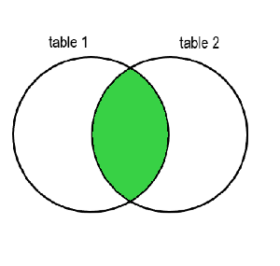
What is a JOIN in SQL?
There are various types of joins, divided into two main categories: INNER joins and OUTER joins.
The biggest difference between an INNER JOIN and an OUTER JOIN is that the inner join will keep only the information from both tables that's related to each other (in the resulting table). An Outer Join, on the other hand, will also keep information that is not related to the other table in the resulting table.
How to Use an INNER JOIN in SQL
The inner join will keep only the information from the two joined tables that is related. If you imagine the two tables as a Venn diagram, the table resulting from an INNER JOIN will be the green highlighted part below where they overlap:
SELECT * FROM table1 JOIN table2 ON relation;

Slide 47
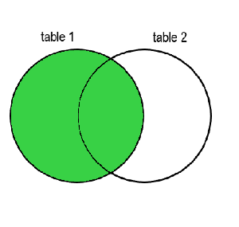
How to Use an OUTER JOIN in SQL
There are three types of Outer Join: LEFT JOIN, RIGHT JOIN, and FULL JOIN. The differences between them involve which unrelated data they keep – it can be from the first table, from the second, or from both of them. The cells without data to fill will have a value of NULL.
LEFT OUTER JOIN in SQL
The LEFT OUTER JOIN, or simply Left Join, will keep the unrelated data from the left (the first) table.
You can imagine it with a Venn diagram with two circles, with the resulting table being the green highlighted part which includes both the common/overlapping part, and the rest of the left circle.
SELECT columns FROM table1 LEFT JOIN table2 ON relation;

Slide 48
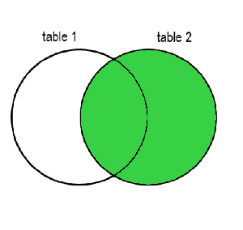
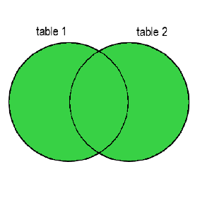
RIGHT OUTER JOIN in SQL
The RIGHT OUTER JOIN, or simply Right Join, will keep the data in the second table that's not related to the first table.
You can imagine it with a Venn diagram with two circles, with the resulting table being the green highlighted part which includes both the overlapping part, and the rest of the right circle.
SELECT columns FROM table1 RIGHT JOIN table2 ON relation;
FULL OUTER JOIN in SQL
You can think of the FULL OUTER JOIN as the combination of a Left Join and Right Join. It will keep all rows from both tables, and the missing data will be filled in with NULL.
You can imagine it with a Venn diagram with two circles, with the resulting table being the green highlighted part which includes everything: the overlapping part, the left circle, and the right circle.
SELECT columns FROM table1 FULL JOIN table2 ON relation;

Slide 49

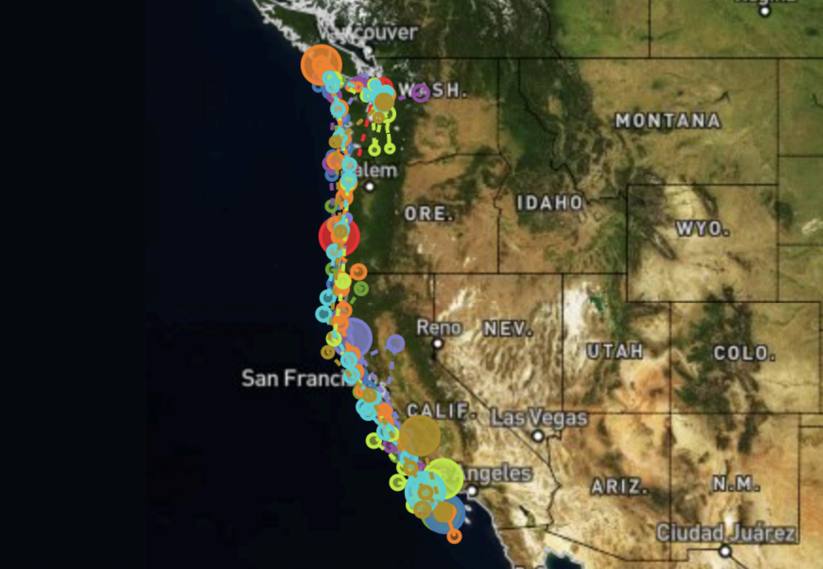
Example
Migrations
Seal lions
id | distance | days
10484 | 1000 | 107
11728 | 1531 | 56
11729 | 1370 | 37
11732 | 1622 | 62
11734 | 1491 | 58
11735 | 2723 | 82
11736 | 1571 | 52
11737 | 1957 | 92
id | name
10484 | Ayah
11728 | Spot
11729 | Tiger
11732 | Mabel
11734 | Rick
11790 | Jolee

Slide 50
Migrations
Seal lions
id | distance | days
10484 | 1000 | 107
11728 | 1531 | 56
11729 | 1370 | 37
11732 | 1622 | 62
11734 | 1491 | 58
11735 | 2723 | 82
11736 | 1571 | 52
11737 | 1957 | 92
id | name
10484 | Ayah
11728 | Spot
11729 | Tiger
11732 | Mabel
11734 | Rick
11790 | Jolee

Slide 51
INNER JOIN
Id | name
10484 | Ayah
11728 | Spot
11790 | Jolee
id | distance
10484 | 1000
11728 | 1531
11735 | 2723

Slide 52
Sea lions JOIN migrations
id | name | id | distance | days
10484 | Ayah | 10484 | 1000 | 107
11728 | Spot | 11728 | 1531 | 56
11729 | Tiger | 11729 | 1370 | 37
11732 | Mabel | 11732 | 1622 | 62
11734 | Rick | 11734 | 1491 | 58

Slide 53
INNER JOIN
Id | name | id | distance
10484 | Ayah | 10484 | 1000
11728 | Spot | 11728 | 1531
11790 | Jolee | 11735 | 2723

Slide 54
INNER JOIN
id | name | Id | distance
10484 | Ayah | 10484 | 1000
11728 | Spot | 11728 | 1531

Slide 55
LEFT OUTER JOIN
Id | name
10484 | Ayah
11728 | Spot
11790 | Jolee
id | distance
10484 | 1000
11728 | 1531
11735 | 2723

Slide 56
LEFT OUTER JOIN
id | name | id | distance
10484 | Ayah | 10484 | 1000
11728 | Spot | 11728 | 1531
11790 | Jolee
 |  | 11735 | 2723

Slide 57
LEFT OUTER JOIN
id | name | id | distance
10484 | Ayah | 10484 | 1000
11728 | Spot | 11728 | 1531
11790 | Jolee | NULL | NULL
NULL | NULL | 11735 | 2723

Slide 58
LEFT OUTER JOIN
id | name | id | distance
10484 | Ayah | 10484 | 1000
11728 | Spot | 11728 | 1531
11790 | Jolee | NULL | NULL

Slide 59
RIGHT OUTER JOIN
Id | name
10484 | Ayah
11728 | Spot
11790 | Jolee
id | distance
10484 | 1000
11728 | 1531
11735 | 2723

Slide 60
RIGHT OUTER JOIN
id | name | id | distance
10484 | Ayah | 10484 | 1000
11728 | Spot | 11728 | 1531
11790 | Jolee | NULL | NULL
NULL | NULL | 11735 | 2723

Slide 61
RIGHT OUTER JOIN
id | name | id | distance
10484 | Ayah | 10484 | 1000
11728 | Spot | 11728 | 1531
NULL | NULL | 11735 | 2723

Slide 62
FULL JOIN
Id | name
10484 | Ayah
11728 | Spot
11790 | Jolee
id | distance
10484 | 1000
11728 | 1531
11735 | 2723

Slide 63
FULL JOIN
id | name | id | distance
10484 | Ayah | 10484 | 1000
11728 | Spot | 11728 | 1531
11790 | Jolee | NULL | NULL
NULL | NULL | 11735 | 2723

Slide 64
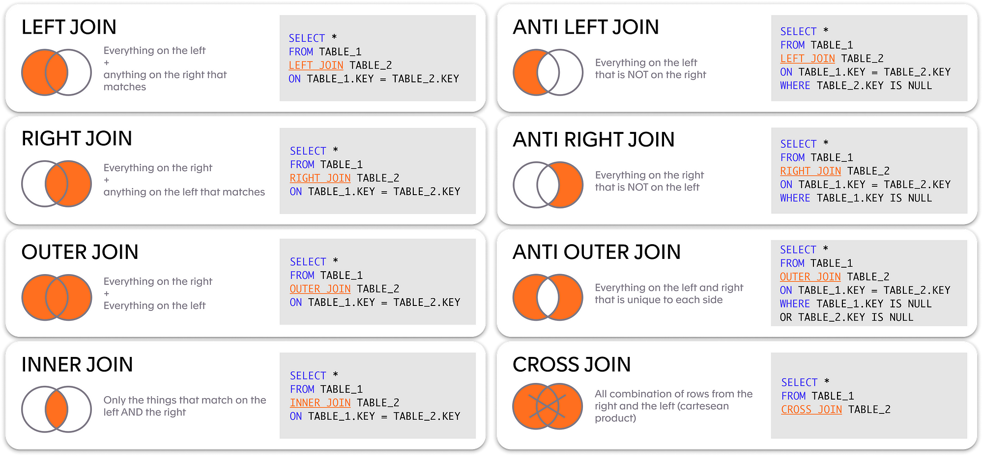
Summary

Slide 65
Practical Questions
Retrieve a list of all albums and their corresponding artists, including albums that do not have associated artists.
Show the first and last names of all employees along with their titles, even if they don't manage anyone.
Display a list of all customers and their invoices, including customers who have not made any purchases (invoices).
List all media types along with the tracks that use them, even if there are no tracks for a particular media type.
Show a list of all albums and their associated artists, as well as artists with no associated albums.

Slide 66
Answers
Retrieve a list of all albums and their corresponding artists, including albums that do not have associated artists.
SELECT Album.AlbumId, Album.Title, Artist.Name
FROM Album
LEFT JOIN Artist ON Album.ArtistId = Artist.ArtistId;
Show the first and last names of all employees along with their titles, even if they don't manage anyone.
SELECT Employee.EmployeeId, Employee.FirstName, Employee.LastName, Employee.Title
FROM Employee
LEFT JOIN Employee AS Managers ON Employee.EmployeeId = Managers.ReportsTo;
Display a list of all customers and their invoices, including customers who have not made any purchases (invoices).
SELECT Customer.CustomerId, Customer.FirstName, Customer.LastName, Invoice.InvoiceId
FROM Customer
RIGHT JOIN Invoice ON Customer.CustomerId = Invoice.CustomerId;

Slide 67
Answers
List all media types along with the tracks that use them, even if there are no tracks for a particular media type.
SELECT MediaType.MediaTypeId, MediaType.Name, Track.Name
FROM MediaType
RIGHT JOIN Track ON MediaType.MediaTypeId = Track.MediaTypeId;
Show a list of all albums and their associated artists, as well as artists with no associated albums.
SELECT Album.AlbumId, Album.Title, Artist.Name
FROM Album
FULL JOIN Artist ON Album.ArtistId = Artist.ArtistId;

Slide 68
How to use Aggregations and Group By functions in SQL

Slide 69



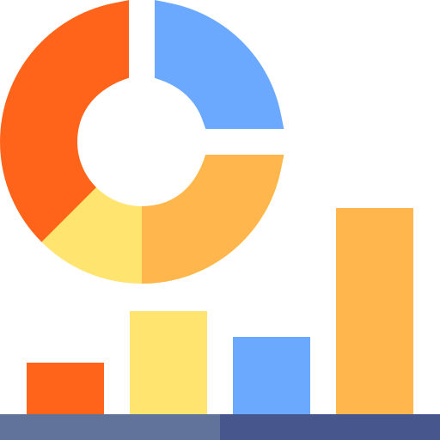



Why do we need to use Group By and Aggregate functions?
The GROUP BY clause in SQL is a powerful feature that allows you to group rows based on the values in one or more columns. It enables you to perform aggregate functions on groups of data, producing summary results from large datasets.
Purpose
Use Cases
Count of Orders, Group By Customer
Data Exploration
Data Aggregation
Grouping by Category and Calculating Average Price
Data Summarisation
Grouping by Day and Calculating Total Sales and Profit
Data Reporting

Slide 70
Aggregate Functions
FUNCTION | DEFINITION | SYNTAX
AVG() | Calculates the AVERAGE of a set of values | SELECT AVG(column1) FROM table_name;
COUNT() | Returns the total number of values in a set | SELECT COUNT(column1) FROM table_name;
Sum() | Returns the SUM of a set of values | SELECT SUM(column1) FROM table_name;
Max() | Returns the MAXIMUM value in a set of values | SELECT MAX(column1) FROM table_name;
MIN() | Returns the MINIMUM value in a set of values | SELECT MIN(column1) FROM table_name;
DISTINCT | Returns the number of unique values in a set of values, Or Returns the unique set of values | SELECT COUNT(DISTINCT column1) FROM table_name; SELECT DISTINCT column1 FROM table_name;

Slide 71
GROUP BY
FUNCTION | DEFINITION | Syntax
GroupBy() |  | SELECT column1, column2, aggregate_function(column3) FROM table_name GROUP BY column1, column2;
Step-by-Step breakdown of each component:
Column1 and column 2: This part specifies the column or columns by which you want to group your data. Rows with matching values in these columns are aggregated into distinct groups.
Aggregate_function(column3): You typically apply aggregate functions, such as SUM, COUNT, AVG, MAX, or MIN, to one or more columns. These functions compute summary values for the data within each group.
Table_name: This identifies the table from which you are retrieving the data.
Group By: This identifies the columns based on which the grouping is performed

Slide 72
GROUP BY with WHERE
FUNCTION | DEFINITION | Syntax
WHERE |  | SELECT column1, aggregate_function(column2) FROM table_name WHERE Column1 Condition GROUP BY column1;
While both GROUP BY and WHERE are used for filtering data, they serve different purposes purposes in querying and manipulating data :
WHERE is used to filter rows before grouping.
GROUP BY is used to group rows after filtering.

Slide 73

GROUP BY:
The GROUP BY clause is used to group rows of data based on the values in one or more columns.
WHERE:​
The WHERE clause is used to filter rows based on specific conditions or criteria. It is used to select a subset of rows that meet a specified condition.
GROUP BY:
GROUP BY is typically executed after the initial dataset has been selected. This means that you can use WHERE to filter rows before applying GROUP BY.
You can use aggregate functions to perform calculations on the grouped data after rows are grouped based on the specified columns.
WHERE:​
WHERE is applied during the initial data retrieval process, which means that rows are filtered based on the specified conditions before any grouping or aggregation occurs.​
After filtering with WHERE, you can then apply GROUP BY to the remaining rows if you wish to perform further aggregation and summarization.​

Slide 74
GROUP BY with HAVING
FUNCTION | DEFINITION | Syntax
HAVING |  | SELECT column1, aggregate_function(column2) FROM table_name GROUP BY column1 HAVING aggregate_function(column2) condition ;
Filtering Groups: The primary function of the HAVING clause is to filter groups of rows that meet certain criteria. It operates on the result set produced by the GROUP BY clause, allowing you to specify conditions that groups must satisfy to be included in the final result.
Aggregate Functions: The conditions specified in the HAVING clause often involve aggregate functions like SUM, COUNT, AVG, MAX, or MIN. These functions are used to calculate summary statistics for each group, and you can apply conditions based on these calculated values.
Group-Level Filtering: Unlike the WHERE clause, which filters individual rows, the HAVING clause applies filter conditions at the group level. This means it filters out entire groups of rows that do not meet the specified conditions.
Notes:
The GROUP BY HAVING clause in SQL extends the capabilities of the GROUP BY clause by allowing you to filter groups of rows based on aggregate values

Slide 75
GROUP BY with WHERE
GROUP BY with HAVING
The WHERE clause is used to filter individual rows before they are grouped.
It operates on the original dataset and is primarily used for row-level filtering.
Use Case: We can use WHERE to filter out orders that occurred before a specific date or products with prices below a certain threshold.
The HAVING clause is used to filter groups of rows after they have been grouped using GROUP BY.
It operates on the result set produced by the grouping operation and is specifically designed for filtering based on aggregate values.
Use Case: We can use HAVING to filter out customer segments with a certain total order count or product categories with a minimum total sales value.

Slide 76
GROUP BY with WHERE
GROUP BY with HAVING
SELECT customer_id, SUM(amount) FROM payment WHERE customer_id >3 GROUP BY customer_id;
SELECT productCategory, SUM(quantity) FROM transactions WHERE productCategory IN ('Kitchen’, Toys') GROUP BY productCategory;
SELECT category, SUM(sales) as total_sales FROM products GROUP BY category HAVING SUM(sales) > 10000;
SELECT customer_segment, COUNT(order_id) as order_count FROM orders GROUP BY customer_segment HAVING COUNT(order_id) >= 10;
SELECT productCategory AVG(UnitPrice) as AvgUnitPrice FROM transactions WHERE productCategory in (‘Kitchen’, ‘Toys’) GROUP BY productCategory HAVING AVG(UnitPrice) > 3;

Slide 77
Things to Remember

Slide 78
Column Selection Restrictions:
When using GROUP BY, you can only select columns that are either part of the grouping columns or included within aggregate functions in the SELECT clause. This means that you cannot select arbitrary columns that are not part of the grouping or aggregation.
For example, if you are grouping by “product category,” you can select “product category” and columns like “SUM(sales)” or “COUNT(*)” in the SELECT clause, but you cannot directly select other columns like “product name” unless they are also part of an aggregate function.
Potential for High Cardinality Groups:
When grouping data, be cautious of creating high cardinality groups. High cardinality groups are groups with a large number of distinct values, which can make the result set unwieldy.
For instance, if you group data by a unique identifier like “customer ID,” you may end up with as many groups as there are customers, making it challenging to work with the result set effectively.
Ambiguity with Non-aggregated Columns:
If you include a column in the SELECT clause that is not part of an aggregate function and is not in the GROUP BY clause, it can lead to ambiguity. The database may not know which specific row’s value to display for that column within each group.
Some databases, like PostgreSQL, allow you to include such columns in the SELECT clause, but the result might not be as expected, as it could return any value from the group.

Slide 79
Exercises
Find Average Unit Price of a Track
Find Minimum, Maximum and Sum of the total purchase amount within an invoice.
Write a SQL Query to find the number of customers and number of unique cities that the customers are from.
Write a SQL query to find the Unique list of Cities the customers are from.
Write a SQL query to find the highest Total Purchase Amount in each city. Return city, maximum Purchase Amount.
Write a SQL query to find the highest Total Purchase Amount in each city. Return city in Ascending order, maximum Purchase Amount.
Write a SQL query to find the highest Unit price of a Track by each composer. Return the Name of the Track and Composer.

Slide 80
Exercises
Write a SQL query to determine the Quantity Purchased, within each invoice, where the Unit Price was greater than $0.99. Return Invoice ID, Quantity and Unit Price.
Write a SQL query to find the highest Total amount by each customer. Filter the result by highest Total amount above 20.00. Return customer id, order date and maximum purchase amount.
Write a SQL query to find the Total amount by each customer. Filter the result by highest Total amount above 20.00. Return customer id, order date and Total purchase amount.

Slide 81
Answers
Find Average Unit Price of a Track
SELECT AVG(UnitPrice)
FROM InvoiceLine il ;
2. Find Minimum, Maximum and Sum of the total purchase amount within an invoice.
SELECT MIN(Total), MAX(Total), SUM (total)
FROM Invoice i ;
3. Write a SQL Query to find the number of customers and number of unique cities that the customers are from.
SELECT COUNT(CustomerID), COUNT(DISTINCT City)
FROM Customer c ;
4. Write a SQL query to find the Unique list of Cities the customers are from.
SELECT DISTINCT City
FROM Customer c ;
​
​

Slide 82
Exercises
5. Write a SQL query to find the highest Total Purchase Amount in each city. Return city, maximum Purchase Amount.
SELECT BillingCity, MAX(Total)
FROM Invoice i
GROUP BY BillingCity ;
6. Write a SQL query to find the highest Total Purchase Amount in each city. Return city in Ascending order, maximum Purchase Amount.
SELECT BillingCity, MAX(Total)
FROM Invoice i
GROUP BY BillingCity
ORDER BY BillingCity ASC ;
7. Write a SQL query to find the highest Unit price of a Track by each composer. Return the Name of the Track and Composer.
SELECT Name,Composer,MAX(UnitPrice)
FROM Track t
GROUP BY Name,Composer ;

Slide 83
Exercises
8. Write a SQL query to determine the Quantity Purchased, within each invoice, where the Unit Price was greater than $0.99. Return Invoice ID, Quantity and Unit Price.
SELECT InvoiceId, Quantity, UnitPrice
FROM InvoiceLine il
WHERE UnitPrice > 0.99
GROUP BY InvoiceId;
9. Write a SQL query to find the highest Total amount by each customer. Filter the result by highest Total amount above 20.00. Return customer id, order date and maximum purchase amount.
SELECT CustomerId ,InvoiceDate , MAX(Total)
FROM Invoice i
GROUP BY CustomerId ,InvoiceDate
HAVING MAX(Total) > 20.00;
10. Write a SQL query to find the Total amount by each customer. Filter the result by highest Total amount above 20.00. Return customer id, order date and Total purchase amount.
SELECT CustomerId ,InvoiceDate , Total
FROM Invoice i
GROUP BY CustomerId ,InvoiceDate
HAVING Total>20.00;

Slide 84
Hands on Practice

Slide 85
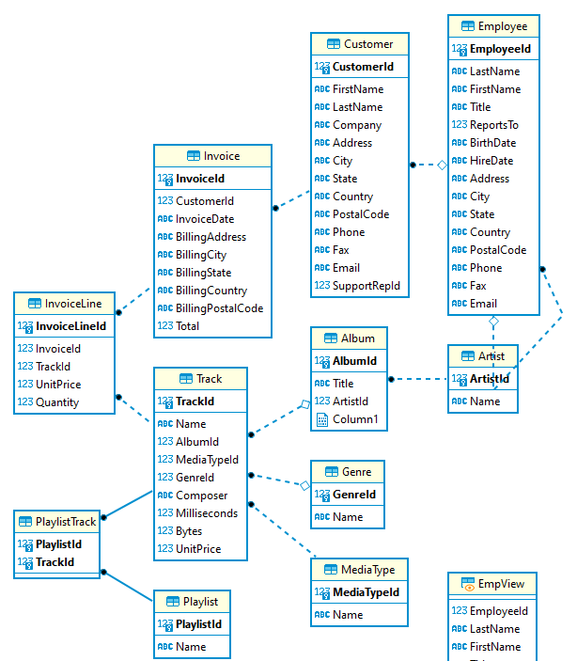
Some pointers
Check for an ERD (Entity Relationship Diagram)
Explore the database/warehouse
See what databases (if applicable),tables, views, schemas are used
Query the information schemas which will have specific tables that hold object metadata.
select * from information_schema.tables where schema_name ='XX' and table_name like '%something%'
select * from information_schema.columns where table_schema ='XX' and table_name ='XX' and column_name like '%something%'
Find out what type of database/warehouse you’re using as sql syntax may vary. You can then google for the appropriate sql syntax for a particular function. E.g. MS SQL Server, Redshift, Snowflake, chinook the db for our sample project
Don’t forget audit columns. If you’re in a data warehouse, are you after all the historical versions of a record, or just the latest? In a database, do you only get the current view with no history? Not handling for audit columns may result in duplicates.
When in doubt, look at some data. Bring back a couple of rows from each table (limit 100, top 100). Trace a record id through various tables to check you’ve got the right logic to get between tables
Use comments (using -- or /**/) can be good way to add notes/clarify what you’re trying to do with each section/join.
Notes:
For our sample data set, in Dbeaver right click the database and select view diagram. In other cases it might be in source documentation or a data modelling tool like SqlDBM.
Redshift/Databricks uses select * from table limit 10, but MS SQL Server uses select top 10 * from table.

Slide 86
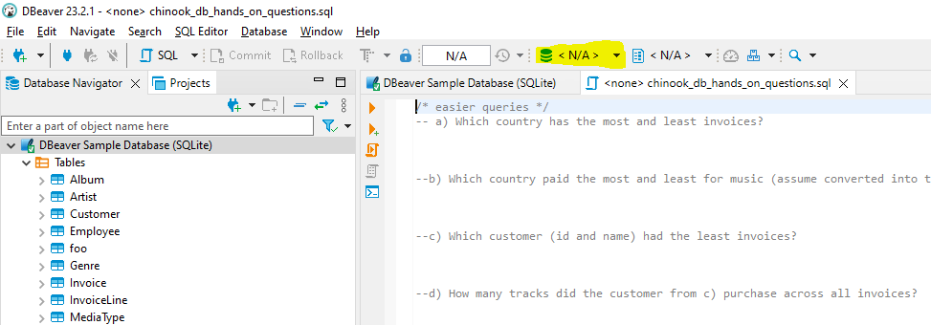
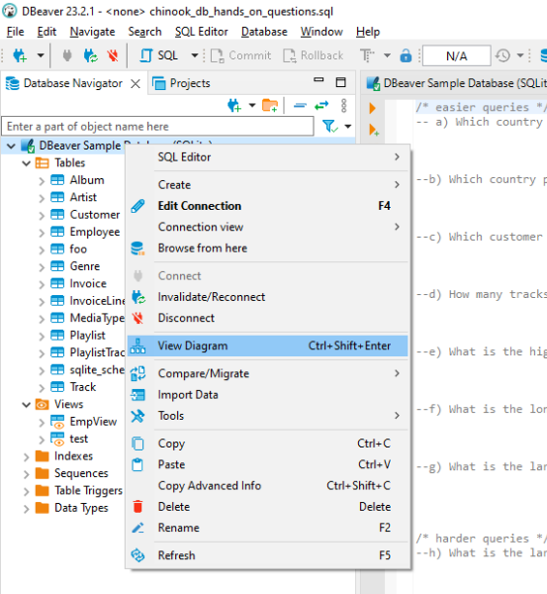
Getting started
In DBeaver, open the file. File > Open File
Connect your question file to the sample DB. Click on the yellow section and select the sample DB.
Right click the DB in the left pane and select ‘View Diagram’ to open the ERD for this database.

Slide 87
/* easier exercises */
Which country has the most and least invoices?
Which country paid the most and least for music (assume converted into the same currency)?
Which customer (id and name) had the least invoices?
How many tracks did the customer from c) purchase across all invoices?
What is the highest price for a track ?
What is the longest album (id and name) in seconds?
What is the largest playlist (id and name) by the number of tracks?

Slide 88
/* easier exercises */ - ANSWERS
Which country has the most and least invoices? Most – USA with 91, least – 15 countries tied with 7
Which country paid the most and least for music (assume converted into the same currency)? Most – USA with 523.06, least – 7 countries tied at 37.62
Which customer (id and name) had the least invoices? Customerid 59, Puja Srivastava with 6 invoices
How many tracks did the customer from c) purchase across all invoices? 36 tracks
What is the highest price for a track ? 1.99
What is the longest album (id and name) in seconds? Albumid 229, Lost, Season 3
What is the largest playlist (id and name) by the number of tracks? Tied fist place by playlisted 1,8 with 3290 tracks both called Music

Slide 89
/* harder exercises */
What is the largest playlist by bytes?
What is the most popular genre by tracks purchased?
Which artist has created work across the most genres? Fact check the result.
What is the most purchased track? Which city has the most purchased tracks?
Which employee supports the most customers?
An employee gets a bonus if they support the most sales by dollars. Which employee will get the bonus?

Slide 90
/* harder exercises */ - ANSWERS
What is the largest playlist by bytes? Playlistid 3 and 10 both called TV Shows with 89.9GB of tracks.
What is the most popular genre by tracks purchased? Rock with 835 tracks
Which artist has created work across the most genres? Fact check the result. Artistid 90, Iron Maiden
What is the most purchased track? Which city has the most purchased tracks? Most purchased tracks have 2 sales, 256 tracks fit this category
Which employee supports the most customers? Employeeid 3, Jane Peacock with 21 distinct customers
An employee gets a bonus if they support the most sales by dollars. Which employee will get the bonus? Jane Peacock with 833.04 in support sales

Slide 91
DAY 2

Slide 92
Subqueries and Derived Tables

Slide 93

What we will cover in this section?
Understanding Subqueries and their usage
Exploring Types of Common Table Expressions
Practical Applications
By the end of this session, you'll be able to use these powerful tools to simplify complex queries, improve query performance, and write cleaner, more maintainable SQL code.

Slide 94
The What, Where, and Types of SQL Subqueries
Based on their Position
Scalar Subquery
- Returns a single value, which means its result should yield one column with a single row.
Nested Subqueries
- A subquery that's nested inside another subquery or main query.
Correlated Subqueries
- A correlated subquery is a subquery that references one or more columns from the outer query.
Based on their Purpose
Subqueries in SELECT
- Used within the SELECT clause to fetch a single value for each row returned by the outer query.
Subqueries in FROM
- Acts as a derived view and the result of the subquery is treated as a table upon which the outer query operates.
Subqueries in WHERE
- Helps filter the rows for the main query using results from the subquery.

Slide 95
Types of Subqueries: Position Matters! 🎯
Scalar Subquery
SELECT COUNT(TrackId)
FROM Track
WHERE AlbumId = (
SELECT AlbumId
FROM Album
ORDER BY LENGTH(Title) DESC
LIMIT 1
);
Returns a single value, which means its result should yield one column with a single row.
Example - Find out how many tracks there are in the album with the longest title.
Nested Subqueries
SELECT Name
FROM Artist
WHERE ArtistId IN (
SELECT ArtistId
FROM Album
WHERE AlbumId IN (
SELECT AlbumId
FROM Track
WHERE GenreId = ‘1’)
);
A subquery that's nested inside another subquery or main query. Can return one or multiple rows, but generally doesn't interact with the outer query.
Example - Retrieve the names of artists who have albums containing tracks of the genre with GenreId = 1.
Notes:
Scalar:
Usage Scenario: When you need to compare against a single value, such as finding the customer with the highest total spent.
When and Where: Use when you're looking for a single piece of data to insert into your main query. For instance, when finding the "average", "maximum", or any other aggregate against which you wish to compare.
Nested Subqueries:
Innermost Subquery: Starting from the innermost subquery, we are selecting the AlbumId from the Track table where the GenreId is '1'. This gives us all the albums that have tracks with this specific genre.
Middle Subquery: The middle subquery then fetches the ArtistId from the Album table, but only for the albums obtained from the previous step. Thus, it returns artists who have made at least one album with a track from the specified genre.
Main Query: Finally, the outermost/main query retrieves the names of the artists based on the list of artist IDs from the middle subquery.

Slide 96
Types of Subqueries: Position Matters! 🎯
Correlated Subquery
A correlated subquery is a subquery that references one or more columns from the outer query. The inner query runs once for each row processed by the outer query. Hence, they're closely tied together, hence the term "correlated".
Example - List the names of artists who have released more than 5 albums.
SELECT Name
FROM Artist a
WHERE 5 < (
SELECT COUNT(AlbumId)
FROM Album
WHERE ArtistId = a.ArtistId
);
Notes:
Inner Query (Subquery): The inner query counts the number of albums (COUNT(AlbumId)) for a specific artist (WHERE ArtistId = a.ArtistId). Here's the catch: notice the reference to a.ArtistId? That a.ArtistId is a column from the outer query's table, Artist. This means the subquery will execute separately for each artist in the outer query, using that artist's ArtistId.
Outer Query (Main Query): The outer query simply lists out the names (Name) of artists. But, due to the WHERE condition, it only selects artists where the result of the inner subquery (i.e., the count of their albums) is greater than 5.
Insights: Correlated subqueries can be thought of as loops. For each row in the outer query, the subquery is evaluated. It's crucial to use them judiciously as they can be performance-intensive, especially with large datasets.

Slide 97
Types of Subqueries: Purpose Driven 🚀
Subqueries in SELECT
Used within the SELECT clause to fetch a single value for each row returned by the outer query.
SELECT ArtistId, Name,(
SELECT COUNT(AlbumId) FROM Album
WHERE ArtistId = a.ArtistId
) AS NumberOfAlbums
FROM Artist a;
Example - For each artist, retrieve their ID, name, and the total number of albums they've produced.
Subqueries in FROM
SELECT a.Name, t.TotalAlbums
FROM Artist a
JOIN (
SELECT ArtistId,
COUNT(AlbumId) AS TotalAlbums
FROM Album
GROUP BY ArtistId
) t ON a.ArtistId = t.ArtistId;
Acts as a derived or inline view. The result of the subquery is treated as a table upon which the outer query operates. A subquery that's nested inside another subquery or main query. Can return one or multiple rows, but generally doesn't interact with the outer query.
Example - Display each artist's name with the total count of their albums using a JOIN operation.
Notes:
Select: This query fetches the artist's ID, name, and the total number of albums they've produced. The subquery in the SELECT clause calculates the number of albums for each artist, which is then presented as a column in the result.
FROM: In this example, we're using a subquery to aggregate the number of albums per artist in the Album table. We then JOIN this aggregated data with the Artist table using the ArtistId. The result displays each artist's name alongside their total album count.

Slide 98
Types of Subqueries: Purpose Driven 🚀
Subqueries in WHERE
Helps filter the rows for the main query using results from the subquery.
SELECT Name
FROM Artist
WHERE ArtistId IN (
SELECT ArtistId
FROM Album
WHERE Title LIKE '%Black%'
);
Example - Find the names of artists who have produced an album with the word ‘Black' in its title.
Notes:
WHERE:
Usage Scenario: To filter the main query results based on a condition that matches values in another table, like fetching all tracks by a specific artist.
When & Where: Best for refining your results based on data from another table without needing a JOIN.
Example: This query fetches artist names who have produced an album with the word Black' in its title. The subquery filters out the ArtistIds from the Album table based on the given condition, and the main query uses these ArtistIds to fetch the corresponding artist names.
FROM: In this example, we're using a subquery to aggregate the number of albums per artist in the Album table. We then JOIN this aggregated data with the Artist table using the ArtistId. The result displays each artist's name alongside their total album count.

Slide 99
Decoding Complexity: The Real-World Significance of SQL Subqueries
Identifying Top Genres:
Retrieve the total sales value for each music genre, ranked from the highest to the lowest sales. This gives us insight into which genres are the most popular among our customers in terms of sales.
SELECT GenreId, SUM(Total) as TotalSales
FROM (
SELECT t.GenreId, SUM(iv.Total) as Total
FROM Invoice iv
JOIN InvoiceLine il ON iv.InvoiceId = il.InvoiceId
JOIN Track t ON il.TrackId = t.TrackId
GROUP BY t.GenreId
) AS subquery
GROUP BY GenreId
ORDER BY TotalSales DESC;
Notes:
Subqueries serve a multitude of purposes. Let’s dive into some practical, hands-on examples.
Subquery: For each invoice, we join it with the InvoiceLine table to get information about each track sold. Then, we join the result with the Track table to get the GenreId for each track. We group by GenreId and aggregate the total sales using the SUM function.
Main Query: We take the output from the subquery and group it by GenreId once again. The reason for this additional aggregation is to ensure that if there were multiple invoices for the same genre, their sales get summed up correctly. Finally, the result is ordered by the total sales in descending order to see which genre has the highest sales.

Slide 100
Introduction to Common Table Expressions (CTE)
What are CTEs?
A Common Table Expression (CTE) is a temporary result set that you can reference within a SELECT, INSERT, UPDATE, or DELETE statement. CTEs are used to simplify complex queries by breaking them into smaller, more readable chunks. They are also beneficial when working with recursive queries.
Example - find the top 5 tracks that have the most sales
WITH TopTracks AS (
SELECT t.TrackId, t.Name AS TrackName,
SUM(il.Quantity) AS TotalSales
FROM Track t
JOIN
InvoiceLine il ON t.TrackId = il.TrackId
GROUP BY t.TrackId, t.Name
ORDER BY TotalSales DESC
LIMIT 5
)
SELECT * FROM TopTracks;
Notes:
A Common Table Expression (CTE) is like a temporary table that lasts only for the duration of your query. It helps in creating modular SQL code, where complicated operations are broken down into simpler steps. Especially when handling hierarchical data or any situation where a subquery is used multiple times, CTEs shine by offering better readability and structure. Think of them as the 'staging area' for your SQL operations, making the process smooth and organized.

Slide 101
When to use CTEs?
Improved Readability: CTEs can simplify your SQL code by segmenting complicated queries into smaller parts, making it easier to read and understand.
Recursive Queries: When you need to run a query that refers to itself (like calculating hierarchical data), CTEs are invaluable. They allow for recursion in SQL, which isn't natively supported in standard subqueries.
Multiple References: If you have a subquery that needs to be referenced multiple times in the main query, instead of repeating the subquery, you can use a CTE.
Sequence of Operations: In cases where a sequence of operations needs to be performed on data, especially in data transformation or ETL processes, CTEs help structure the steps in a clear and logical order.

Slide 102
Identifying Top 3 Best-Selling Artists with CTEs
Example - Find the top 3 artists based on sales
WITH ArtistSales AS (
SELECT ar.Name AS ArtistName,
SUM(iv.Total) AS TotalSales
FROM Artist ar
JOIN Album al ON ar.ArtistId = al.ArtistId
JOIN Track t ON al.AlbumId = t.AlbumId
JOIN InvoiceLine il ON t.TrackId = il.TrackId
JOIN Invoice iv ON il.InvoiceId = iv.InvoiceId
GROUP BY ar.Name
)
SELECT
ArtistName,
TotalSales
FROM ArtistSales
ORDER BY TotalSales DESC
LIMIT 3;

Slide 103

Quiz
Join at menti.com
Code: 3344 8151

Slide 104
Exercise
Subqueries
List the names of artists who have released more than 5 albums.
Retrieve the track names that are longer in duration than the average track duration.
Which artists have produced tracks longer than 8 minutes but do not have any album named 'Greatest Hits’
List the genres which have more tracks than the genre ‘Jazz'.
CTEs
Fetch the total number of tracks for each album.
List all artists who have more albums than the average.
Identify the top 5 most expensive tracks and retrieve their details including track name, price, associated album title, and the name of the artist who created them.

Slide 105
Table Manipulation

Slide 106
TABLE MANIPULATION
Agenda & Table of Contents
1
CREATE, DROP, ALTER
2
INSERT/UPDATE/DELETE
3
EXERCISES
4
QUIZ
Notes:
Tags: agenda, list, numbers

Slide 107
CREATE TABLE
text
The CREATE command in SQL is used to create new database objects, such as tables, indexes, views, or databases themselves. It also allows you to define the structure and properties of these objects.
Need to specify the table name, column names and what their types are
Can go further by adding constraints (e.g. not null), specifying a primary/foreign key, having a default value, etc
CREATE TABLE IF NOT EXISTS Employees (
EmployeeID INT PRIMARY KEY,
FirstName VARCHAR(50) NOT NULL,
LastName VARCHAR(50),
Email VARCHAR(100) UNIQUE
);
Why add IF NOT EXISTS?
CREATE TEMPORARY TABLE employees_tmp_table AS
SELECT * FROM Employees where currently_employed IS TRUE
AND Email IS NOT NULL;
Notes:
Tags: text, list, principles

Slide 108
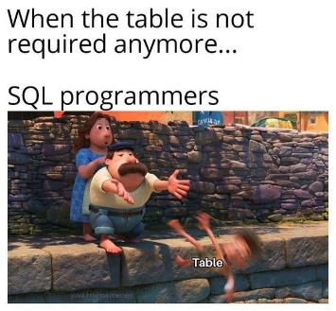
DROP TABLE
text
The DROP command is used to remove database objects, such as tables, views, or indexes. Be careful! DROP, permanently deletes the specified object and its associated data.
DROP TABLE
Users;
DROP TABLE IF EXISTS
Users;
Notes:
Tags: text, list, principles

Slide 109
ALTER TABLE
text
The ALTER command is used to modify the structure of an existing database object. You can use ALTER to add, modify, or delete columns, constraints, or other properties of a table, or to change the name of a table.
It is for when we change our minds about some aspect of the table after table creation. You can also change this directly in DBeaver using the UI for convenience.
ALTER TABLE Employees ADD COLUMN PhoneNumber VARCHAR(15);
ALTER TABLE Employees ALTER COLUMN Age TYPE SMALLINT;
ALTER TABLE Employees RENAME COLUMN FirstName to first_name;
ALTER TABLE Employees DROP COLUMN;
Notes:
Tags: text, list, principles

Slide 110
INSERTS
text
A significant amount of SQL work is in extracting, transforming and loading data to populate or ‘seed’ tables with initial data. In future we may also want to add new rows of data to our tables. The insert statement is how we do that.
INSERT INTO table_name (column1, column2, column3, ...)
VALUES (value1, value2, value3, ...);
INSERT INTO EmployeeTable(employee_ID, first_name, last_name, age, position_type)
SELECT id, firstName, lastName, age, ‘FULL_TIME’
FROM legacyEmployeeTable
WHERE currently_employed = TRUE;
WITH document_date AS
(SELECT MAX(date) AS newest_date
FROM payRevisions
),
INSERT INTO renumerationTable(file_ID, file_type, renum_amount, dt_last_reviewed)
SELECT id, ‘PDF’, salary, newest_date FROM document_date, payRevisions;
Notes:
Tags: text, list, principles

Slide 111
UPDATES
text
The UPDATE statement is used to modify existing records in a table. It's particularly handy when you need to change data due to corrections, updates, or other reasons. Clauses are very important to ensure we only update the right data.
Common examples of use might be updating an employees income, updating whether a record is currently valid, updating the date a record was last altered.
UPDATE table_name SET column1 = value1, column2 = value2, ... WHERE condition;
WITH tempRecTable AS (
SELECT MAX(record_sales) AS quantity
FROM salesTable
)
UPDATE Records
SET sales_quantity = quantity FROM tempRecTable
WHERE Album_id IN (SELECT Album_id FROM britishRecordsCompany WHERE Artist = ‘Bruno Mars’);
Notes:
Tags: text, list, principles

Slide 112
DELETES
text
The DELETE statement is used to remove rows from a table. It should be used carefully with clauses to remove only the desired data, otherwise we can unintentionally lose rows.
DELETE FROM table_name WHERE condition;
DELETE FROM Records WHERE record_type = ‘ARPS-382’ OR Bytes > 6320000;
A ‘soft delete’ is a good alternative if we want data to be recoverable. It marks a record as no longer active or valid without deleting it from the database. In practice, this is a true/false column named something like ‘IsDeleted’, ‘IsActive’ or ‘IsArchived’ which is used as a filter.
Notes:
Tags: text, list, principles

Slide 113

A quick interlude on SQL Injection
text
In 2008, a series of attacks exploited the SQL injection vulnerabilities of Microsoft's IIS web server and SQL Server database server. The attack didn’t require guessing the name of a table or column, and instead corrupted all text columns in all tables in a single request. A HTML string that references a malware JavaScript file was appended to each value. When that database value was later displayed to a website visitor, the script attempted several approaches at gaining control over a visitor's system. The number of exploited web pages was estimated at 500,000.
On August 17, 2009, an American citizen, Albert Gonzalez, and two unnamed Russians were charged with the theft of 130 million credit card numbers primarily from 7-Eleven using an SQL injection attack. Reportedly "the biggest case of identity theft in American history”.
On March 27, 2011, www.mysql.com, the official homepage for MySQL, was compromised by a hacker using SQL blind injection
Mitigation: the only sure way to prevent SQL Injection attacks is input validation and parametrized queries including prepared statements. The application code should never use inputs directly – they need to be sanitized first.
Notes:
Tags: text, list, principles

Slide 114
Time to check we’re all still awake…
text
Practice Questions
Create a new table ‘EmployeeRoster’ with just the columns EmployeeId, LastName, FirstName, Title, ReportsTo from the Employee table, and the 8 rows of data. The column types should be inherited automatically.
Our company has acquired Apple Inc. and our customer Tim Goyer has become a new employee – ‘Sales Support Agent’. Insert them as a row to the Employee table by selecting FirstName, LastName from the Customer table where Company has the name ‘Apple Inc.’ Have them report to Nancy Edwards. You may insert EmployeeID as 9. For an extra challenge, you could find the max EmployeeId of this table and iterate by 1 instead of hard coding the value.
Delete Tim Goyer from the Customer table based on his first and last name. You will notice that this record is gone forever!
Using a CTE referencing the Employee table, update the ‘Sales Support Agent’ who was hired first to ‘Sales Manager’ in EmployeeRoster and also update their ’ReportsTo’ column to the value 1.
Add a column to the table called ‘ActiveCustomers’ with type Integer. The syntax for adding a column is : ALTER TABLE tableName ADD COLUMN columnName Type;)
Challenge: Using a subquery referencing the Customer table (SupportRepId row), update the ActiveCustomers column for all rows in the Employee table as a count of the number of customers each Employee is handling

Slide 115
ANSWERS
text
--a)
CREATE TABLE if not exists EmployeeRoster as
select EmployeeID, LastName, FirstName, Title, ReportsTo
from Employee;
--b)
With max_id as
(select max(EmployeeId)+1 as max_em_id
from EmployeeRoster)
INSERT INTO EmployeeRoster(EmployeeId, LastName, FirstName, Title, ReportsTo)
SELECT max_em_id, LastName, FirstName, 'Sales Support Agent', 2
FROM max_id, Customer
WHERE Company = 'Apple Inc.';
--c)
delete from Customer where FirstName = 'Tim' and LastName = 'Goyer';
--d)
UPDATE EmployeeRoster
SET Title = 'Sales Manager', ReportsTo = 1
WHERE EmployeeId =
(select EmployeeId from Employee
where Title = 'Sales Support Agent'
order by HireDate ASC
Limit 1);
--e)
ALTER TABLE EmployeeRoster
ADD COLUMN ActiveCustomers INT;
--f)
UPDATE EmployeeRoster
SET ActiveCustomers = (
SELECT COUNT(*) AS customer_count
FROM Customer
WHERE EmployeeRoster.EmployeeId = Customer.SupportRepId
);

Slide 116
How to manipulate
String & Dates

Slide 117



When would we want to manipulate our data?
Purpose
Use Cases
Data Cleaning
Standardisation & Validation
Data Extraction
Reporting & Data Presentation
Data Formatting & Transformation
Optimise queries
Notes:
Data Cleaning: String manipulation helps clean and standardize data. For example, you can correct formatting inconsistencies in names or addresses.
Data Extraction: String functions are essential for extracting meaningful information from text fields, such as parsing email addresses or extracting product codes.
Data Formatting: Formatting data is helpful for custom analysis. Transformation to integrate data from different sources
--
Standardisation & Validation: improve data integrity and prevent errors in your dataset, better analysis, data conforms to predefined rules or constraints
Reporting & Data Presentation: presenting information to users in a human-readable format.
Optimisation: queries improve the performance of SQL queries, as poorly constructed manipulations can lead to slower query execution

Slide 118
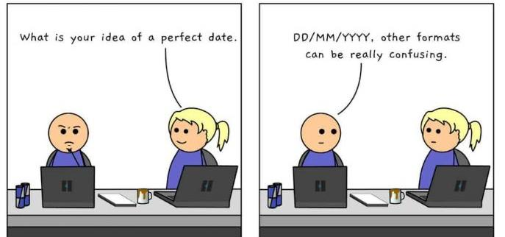

Example of why we need to manipulate values?

Slide 119
String Manipulation Functions
Method | Definition
CONCATENATE | Add strings together
SUBSTRING | Extracts some characters from a string
STRING LENGTH | Function returns the length of a string
CASE FORMATTING UPPER LOWER | Function returns characters in a string in all upper / lower case
TRIM LEFT TRIM RIGHT TRIM | By default, the TRIM() function removes leading and trailing spaces from a string
REPLACE | Function replaces all occurrences of a substring within a string, with a new substring
CASE Statement | Expression goes through conditions and returns a value when the first condition is met
Please be aware that different databases may have a different function name for the same purpose.
For that reason, it’s good practice to check documentation for syntax and definition!
https://www.sqlite.org/lang_corefunc.html
How to read functions For example: substr( string, start, length )

Slide 120
Date Manipulation Functions
Please be aware that different databases may have a different function name for the same purpose.
For that reason, it’s good practice to check documentation for syntax and definition!
https://www.sqlite.org/lang_corefunc.html
How to read functions For example: DATEADD(interval, number, date)
Method | Definition
Date Add | function adds a time/date interval to a date and then returns the date
Date difference | function returns the difference between two dates
Date Part | returns a specified part of a date
Day,Month,Year | function returns the specified part of a specified date
Date | function returns the result as a string value
Current Timestamp | function returns the current system date and time
Get Date | function returns the current database system date and time

Slide 121
Exercises
Combine the first and last name
Flag names that start with the letter ‘m’
Distinct / order by
Finding the domain of an email using instr and substring
Finding the length of phone employee phone numbers
Standardising phone numbers
Formatting letter case
Fixing spelling using the replace function
Time since the last sale

Slide 122


Menti Time
1797 8032
https://www.menti.com/alrn8xhajhci

Slide 123
Best Practices & Performance Tuning

Slide 124

ASHISH DUBEY
Senior Specialist Lead
Data & AI
ashdubey@deloitte.com.au

Slide 125
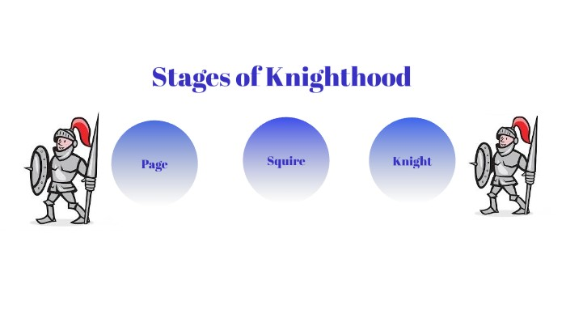

Slide 126
SQL execution plan
Query Cache
Parser
Preprocessor
Query Optimiser
Client
Query Execution Engine
Storage Engines
Data
RDBMS

Slide 127

Index

Slide 128
Constraints
Index benefits
Variety Indexes
GROUP BY
Avoid full table scans
Index
ORDER BY
COUNT(*)
Jump to desired Row(s) in table
JOINS

Slide 129
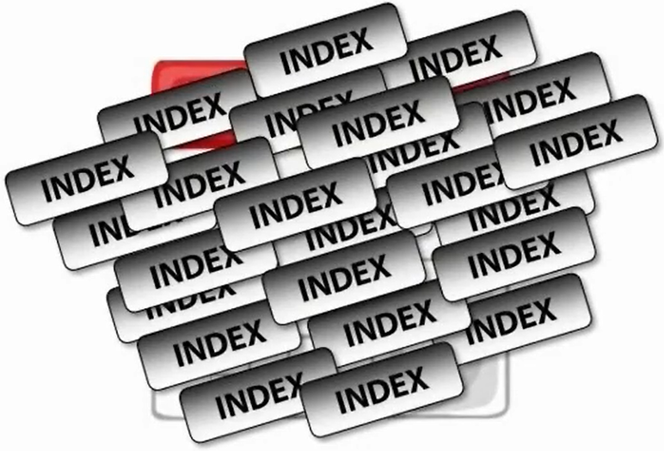
Index – best practices
Waste Space
Slow changes
Avoid if accessing entire table
Create index for columns used in WHERE clause
Subsetting 15%

Slide 130
Difference between Clustered and Non-Clustered Index
Sr. No | Clustered | Non-clustered
1 | A clustered index is used to define the order or to sort the table or arrange the data by alphabetical order just like a dictionary. In SQL Server, the primary key constraint automatically builds a clustered index on a column. | A non-clustered index collects the data at one place and records at another place.
2 | It is faster than a non-clustered index. | It is slower than the clustered index.
3 | It demands less memory to execute the operation. | It demands more memory to execute the operations.
4 | It permits you to save data sheets in the leaf nodes of the index. | It never saves data sheets in the leaf nodes of the index.
5 | A single table can consist of a sole cluster index. | It can consist of multiple non-clustered indexes.
6 | It has the natural ability to store data on the disk. | It does not have the natural strength to store data on the disk.

Slide 131
Best Practices
Notes:
Menti quiz: two slides – called SQL Bootcamp: Database, data warehouse, datamart

Slide 132
#1 Avoid using SELECT *
Inefficient
SELECT * FROM Customers

Slide 133
#1 SELECT fields instead of using SELECT *
Inefficient
SELECT * FROM Customers What happens when schema changes? Can this query use index? It burdens database resources by querying a lot of unnecessary data
Efficient
SELECT FirstName, LastName, Address, City, State, Zip FROM Customers This query only pulls the required information for mailing addresses It does not burden database resources by querying a lot of unnecessary data

Slide 134
#2 Avoid SELECT DISTINCT
Inefficient and inaccurate
SELECT DISTINCT FirstName, LastName, State FROM Customers

Slide 135
#2 Avoid SELECT DISTINCT
Inefficient and inaccurate
SELECT DISTINCT FirstName, LastName, State FROM Customers SELECT DISTINCT works by GROUPing all fields in the query to create distinct results. To accomplish this goal however, a large amount of processing power is required. This query doesn’t account for multiple people in the same state having the same first and last name
Efficient and accurate
SELECT FirstName, LastName, Address, City, State, Zip FROM Customers By adding more fields, unduplicated records are returned without using SELECT DISTINCT. The database does not have to group any fields, and the number of records is accurate.

Slide 136
#3 Do not use WHERE to create joins
Inefficient
SELECT Customers.CustomerID, Customers.Name, Sales.LastSaleDate FROM Customers, Sales WHERE Customers.CustomerID = Sales.CustomerID

Slide 137
#3 Create joins with INNER JOIN (not WHERE)
Inefficient
SELECT Customers.CustomerID, Customers.Name, Sales.LastSaleDate FROM Customers, Sales WHERE Customers.CustomerID = Sales.CustomerID This type of join creates a Cartesian Join, also called a Cartesian Product or CROSS JOIN.
Efficient
SELECT Customers.CustomerID, Customers.Name, Sales.LastSaleDate FROM Customers INNER JOIN Sales ON Customers.CustomerID = Sales.CustomerID To prevent creating a Cartesian Join, use INNER JOIN instead.

Slide 138
#4 Do not use HAVING to define filters
Inefficient
SELECT Customers.CustomerID, Customers.Name, Count(Sales.SalesID) FROM Customers INNER JOIN Sales ON Customers.CustomerID = Sales.CustomerID GROUP BY Customers.CustomerID, Customers.Name HAVING Sales.LastSaleDate BETWEEN #1/1/2016# AND #12/31/2016#

Slide 139
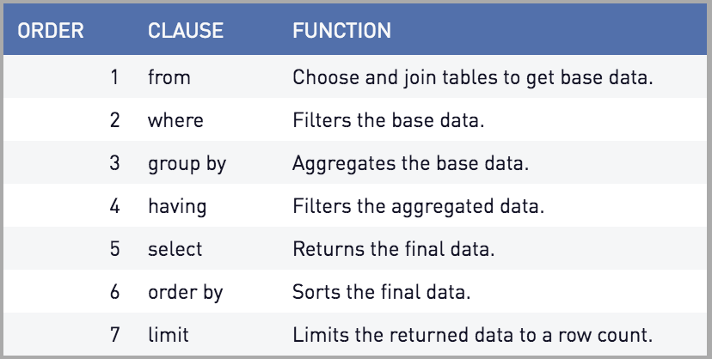
#4 Do not use HAVING to define filters
Inefficient
SELECT Customers.CustomerID, Customers.Name, Count(Sales.SalesID) FROM Customers INNER JOIN Sales ON Customers.CustomerID = Sales.CustomerID GROUP BY Customers.CustomerID, Customers.Name HAVING Sales.LastSaleDate BETWEEN #1/1/2016# AND #12/31/2016#

Slide 140
#4 Do not use HAVING to define filters
Inefficient
SELECT Customers.CustomerID, Customers.Name, Count(Sales.SalesID) FROM Customers INNER JOIN Sales ON Customers.CustomerID = Sales.CustomerID GROUP BY Customers.CustomerID, Customers.Name HAVING Sales.LastSaleDate BETWEEN #1/1/2016# AND #12/31/2016# This query would pull all sales records from the Sales table, then filter for records generated in the year 2016, and finally count the records in the dataset. HAVING should only be used when filtering on an aggregated field. In the query above, we could additionally filter for customers with greater than 5 sales using a HAVING statement. HAVING Count(Sales.SalesID) > 5

Slide 141
#4 Use WHERE instead of HAVING to define filters
Inefficient
SELECT Customers.CustomerID, Customers.Name, Count(Sales.SalesID) FROM Customers INNER JOIN Sales ON Customers.CustomerID = Sales.CustomerID GROUP BY Customers.CustomerID, Customers.Name HAVING Sales.LastSaleDate BETWEEN #1/1/2016# AND #12/31/2016#
Efficient
SELECT Customers.CustomerID, Customers.Name, Count(Sales.SalesID) FROM Customers INNER JOIN Sales ON Customers.CustomerID = Sales.CustomerID WHERE Sales.LastSaleDate BETWEEN #1/1/2016# AND #12/31/2016# GROUP BY Customers.CustomerID, Customers.Name

Slide 142
#5 Use wildcards at the end of a phrase only
Inefficient
SELECT FirstName FROM Customers WHERE FirstName LIKE ‘%J%’
Efficient
SELECT FirstName FROM Customers WHERE FirstName LIKE ‘J%’

Slide 143
#6 Use LIMIT to sample query results
SELECT Customers.CustomerID, Customers.Name, Count(Sales.SalesID) FROM Customers INNER JOIN Sales ON Customers.CustomerID = Sales.CustomerID WHERE Sales.LastSaleDate BETWEEN #1/1/2016# AND #12/31/2016# GROUP BY Customers.CustomerID, Customers.Name LIMIT 10

Slide 144
#7 Run your query during off-peak hours
The more of the following criteria your query has, the more likely of a candidate it should be to run during off peak hours:
Selecting from large tables (>1,000,000 records) Cartesian Joins or CROSS JOINs Looping statements SELECT DISTINCT statements Nested subqueries Wildcard searches in long text or memo fields Multiple schema queries

Slide 145
Database vs
Data Warehouse vs
Datamart
Notes:
Menti quiz: two slides – called SQL Bootcamp: Database, data warehouse, datamart

Slide 146



A Common Data Landscape
Data Lake
Consumers
Sources
Data Warehouse
Database
OLAP
Users
OLTP
Staging Layer
Raw Layer
Modelled
Layer
Consumption Layer
1:1 copy of source data with audit fields like landing timestamps
History stitched version of source data with audit columns like active_ind and effective from/to timestamps.
Enterprise view of data – concepts. Stored in most granular form. Dimensional data model – facts and dims.
Data formatted so it is easy to understand for end-users or reporting. Can contain aggregates.
Reporting
Optimised to record transactional data, often without history – current view of the world.
Analytical Models
ELT or ETL
Notes:
Typical structure of data warehousing projects have sources, a data lake, a data warehouse and consumers.
Sources will often be in the form of a database – say a system that holds stores a record for each item that was purchase/scanned at a checkout. Our first ‘D’ word. Database are OLTP.
OLTP – online transaction processing
This is different to our second ‘D’ word, data warehouse. We’ve covered previously in data warehousing training the different layers in a data warehouse.
OLAP – online analytical processing
Process of getting data from source > data lake > data warehouse called ELT. Sometime might use ETL instead.

Slide 147
Data Lakehouse Architecture
Data Lake
+
Consumers
Sources
Data Warehouse
= Data Lakehouse
Database
OLAP
Users
OLTP
Staging Layer
Raw Layer
Modelled
Layer
Consumption Layer
1:1 copy of source data with audit fields like landing timestamps
History stitched version of source data with audit columns like active_ind and effective from/to timestamps.
Enterprise view of data – concepts. Stored in most granular form. Dimensional data model – facts and dims.
Data formatted so it is easy to understand for end-users or reporting. Can contain aggregates.
Reporting
Optimised to record transactional data, often without history – current view of the world.
Analytical Models

Slide 148

Modelled and Consumption Layers
Consumers
Sources
Data Warehouse
Database
Users
Staging Layer
Raw Layer
Modelled
Layer
Consumption Layer
Finance EOM Report
Reporting
dim
dim
dim
dim
dim
fact
dim
Sales Dataset
Files
dim
dim
Analytical Models
dim
fact
dim
dim
Notes:
Modelled layer – data for the entire enterprise, usually a dimensional data model with facts and dims.
Can be star or snowflake schema.
Contains history – we’ve talked about CDC.
Also connections between objects using surrogate keys.
Minimal duplication of data, single source of truth for a piece of data.
Consumption layer is user/reporting focused.
Would surface the source keys as well as surrogate keys. Aggregations, or views/objects that are pre-joined so convenient for users to access.
Can have repetition of data as use-case/reporting dependent.

Slide 149
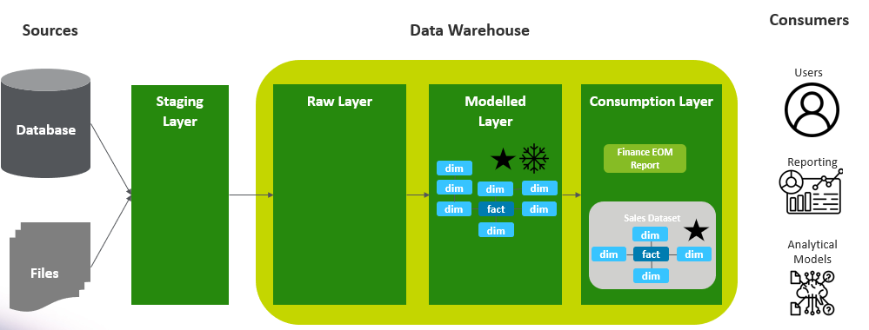
Datamart
Consumers
Sources
Database
Users
Datamart
A datamart is a subset of data that’s for a specific function or group of users – like the Finance or Sales teams.
It can be in the consumption layer of a data warehouse, as above. It can also a lite data warehouse that only contains a couple of data sources, see left.
The datamart can contain a dataset of things the Finance team are interested in. It can also have aggregated and/or flattened tables suited for a particular report.
Reporting
Files
Analytical Models
Notes:
Datamart – think of it like a sub set of a data warehouse, where .
Difference in the way the consumption layer is set up. Can be flattened tables that you point a report to. It can also be a star-schema dataset which is then used as the dataset for reporting.

Slide 150
Summary
Database – Organised collection of structured data. Often OLTP system suited for recording transactions.
Data Warehouse – Well governed source of data from multiple source systems that has been modelled according to business processes/use and represents a single source of truth for the enterprise. OLAP.
Data Lake – Place where you can store data – structured, semi structured and unstructured. With cloud hyperscalers not limited by storage – AWS S3, Azure Blob Storage, GCP Cloud Storage.
Data Lakehouse – Data architecture that includes a data lake and a data warehouse.
Datamart – Subset of an enterprise data warehouse organised by subject or business area. The reduced dataset only shows data relevant for that subject or business area, making it easier to navigate and query.
Data Model – Defines how different objects or concepts are organised and related. Can be for a database or a data warehouse.

Slide 151
Additional Resources

Slide 152
Feedback

Slide 153
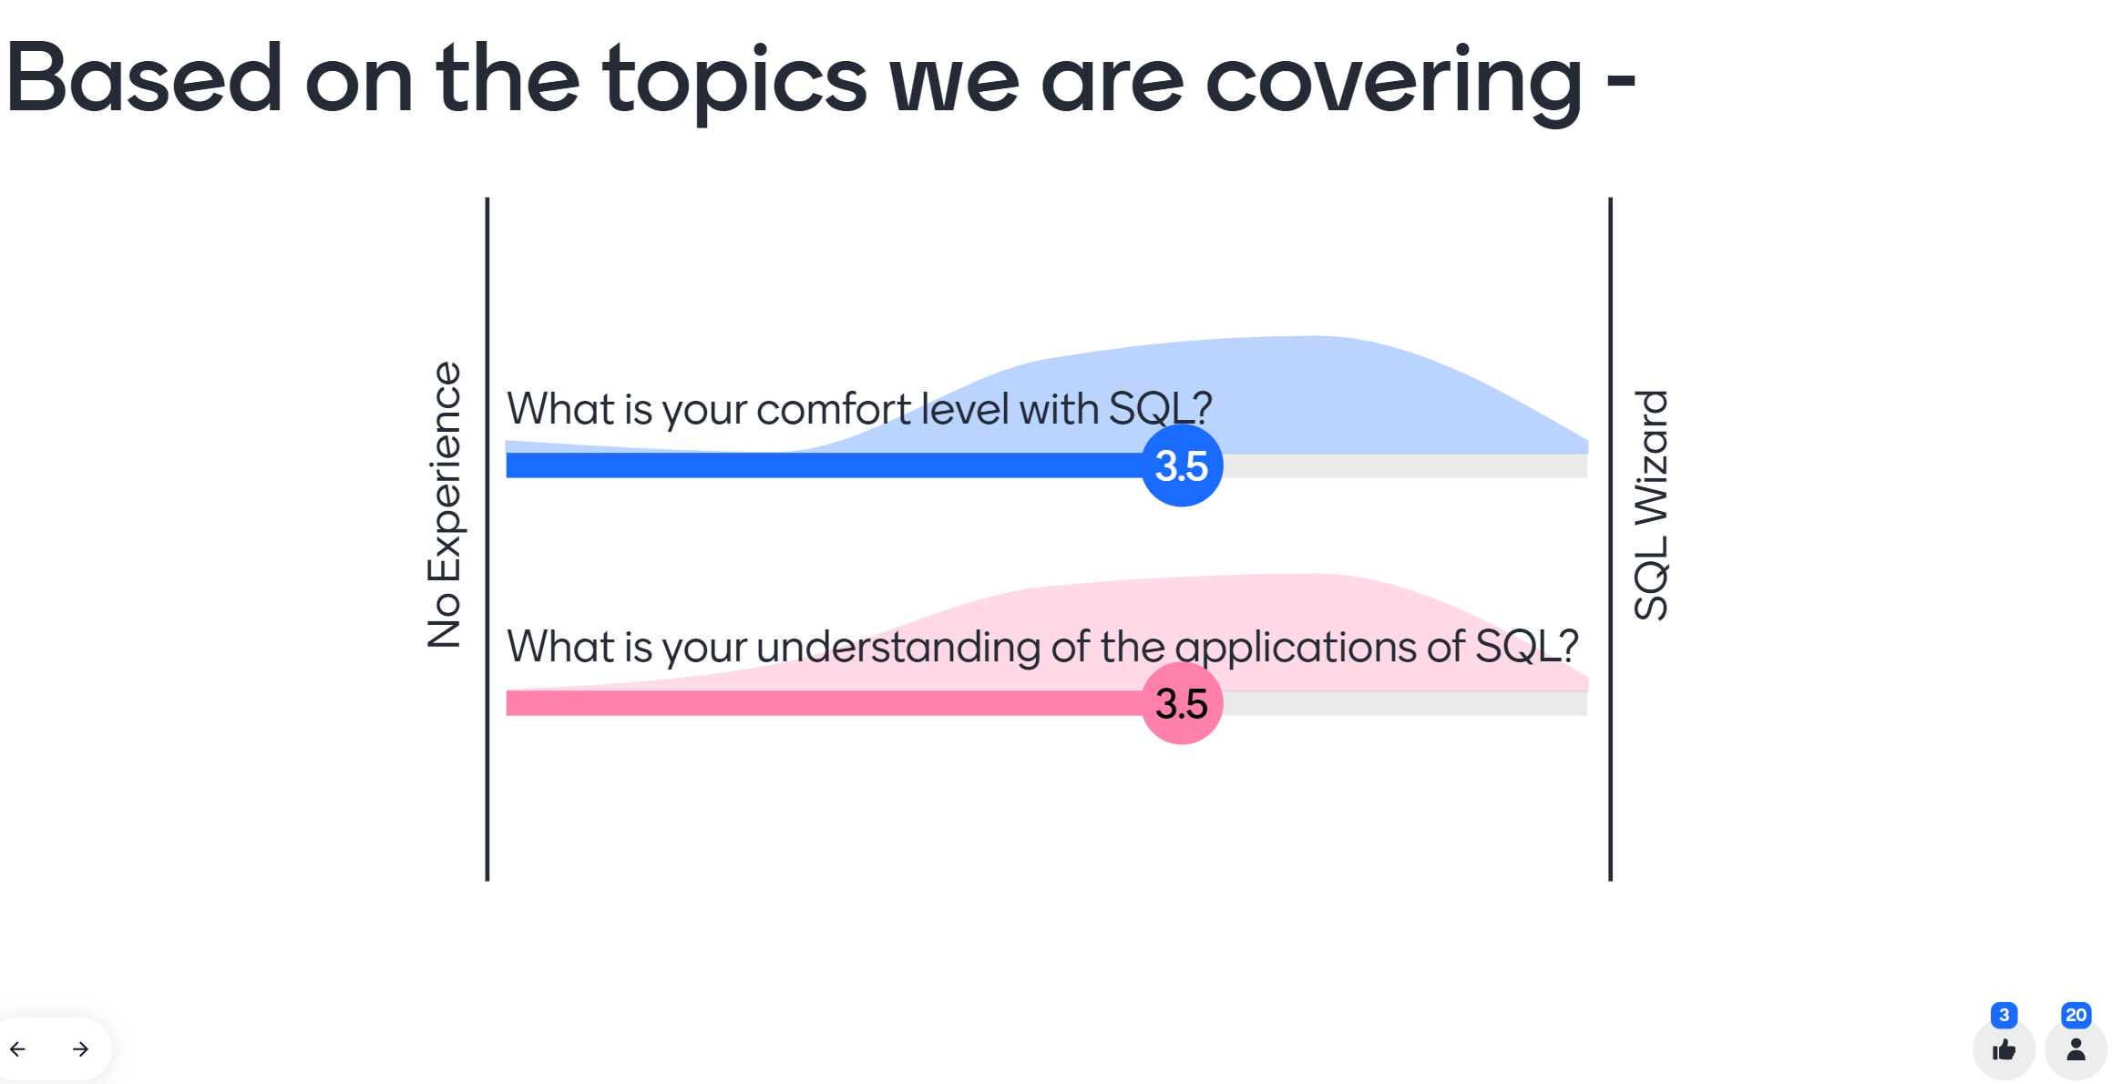
Menti Results
Day 1 Morning Pulse Check

